Slide 1
Creating Maximum Value:
Lean Management in Healthcare

Slide 2
Creating Maximum Value:
Lean Management in Healthcare
Session 1, Lesson 1
Introduction to Lean
Jonathan R Modest, MBA, MPH
Instructor

Slide 3


Slide 4
Who are We?
Instructor
Jonathan Modest, MBA, MPH
  Senior Administrative Manager, MGH Urology
  Brandeis University, ’08
  BUSPH ’13
  Questrom ’16
Teaching Assistant
Lauren Tamburello
Program Manager, BIDMC Urology
  Boston University, ’15
  BUSPH, ‘17
Guest Speakers
Lindsey Pabst, MBA
Emily Correa, MPH, MS

Slide 5
Class Structure
Didactic
Guest speakers and industry insight
Class exercises and breakouts
Synthesis of assigned readings
Personal reflection
Case studies and discussion
Experiential Learning – Lean Management Projects
Useful skills in project management, quality improvement and beyond based on the experience of those who live and breath this work
Notes:
Recognizing that quality improvement is often an added requirement to day-to-day operations

Slide 6
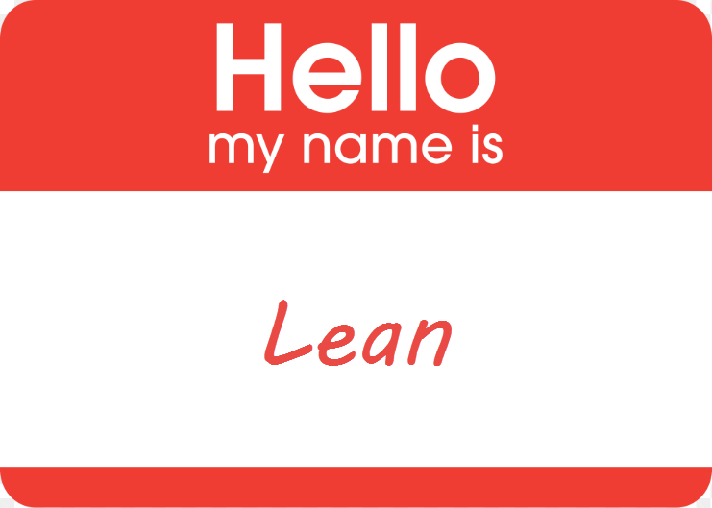
Introduction to lean

Slide 7
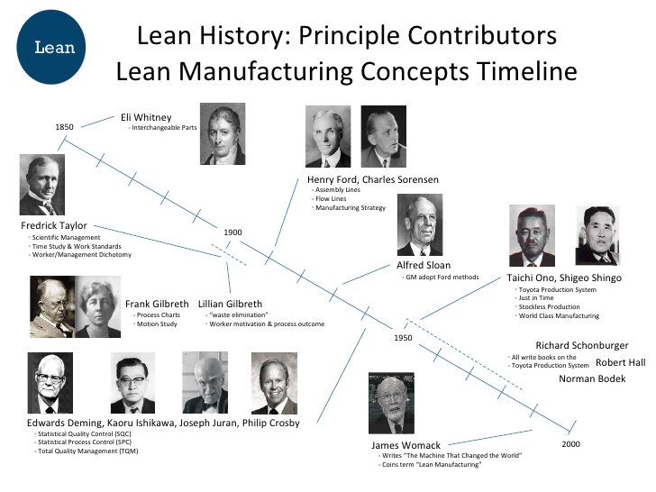
History of Lean
Notes:
The principles of Lean have been around for a long time. In the 1930’s, Taiichi Ohno and others at Toyota revisited Ford’s original thinking and invented the Toyota production system.
We here at Toyota have been doing lean for over 50 years and have just begun our journey – this is a methodology and a mindset, it is not a destination

Slide 8
What is Lean (in Healhtcare)
Maximize customer value while minimizing waste – creating more value for the customer with fewer resources
  Working smarter not harder
Ultimate goal: perfect value to the customer through a perfect process that has zero waste
Values all members of the patient care team
Can be implemented by anyone
Notes:
Processes can be broken down into tasks. In this class, we will explore 3 versions of a process – what we think the process is, what the actual process is and what should it be

Slide 9

An Approach and Philosophy
“Lean is both an approach to work and an organizational philosophy
A set of methodologies designed to solve organizational challenges and improve results
Culture of continuous improvement and people development
Lean Mean
…or downsizing, or outsourcing, or working faster … or just common sense

Slide 10
Why Lean?
Quality
Satisfaction
Reduces customer wait times
Reduces errors
Standardizes workflow
Reduces unnecessary workload, duplicative work and/or rework
Improves hand-offs
Increases productivity
Reduces inventory
“At Toyota we get brilliant results from average people managing a brilliant process.
Others get average results from brilliant people managing broken processes.”
--The Toyota Motor Company
Efficiency
People are not the cause of problems, bad processes are.

Slide 11
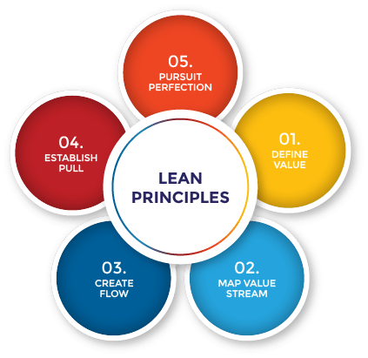
5 Principles of Lean
Always compete
against perfection
not just your
current competition
A system in which nothing is produced by a supplier until the customer signals a need
Specify value from the perspective
of the customer
Progressive achievement of value creating steps with minimal queues and no stoppages or backflows of product, information or services
Characterize the Value Stream (set of activities) for each product / process while removing waste.
Notes:
Each of these principles will be weaved into the various class sessions

Slide 12
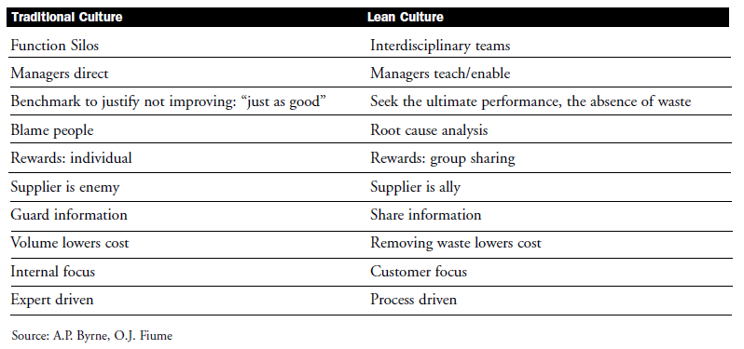
Lean vs. Traditional Culture

Slide 13
Creating Maximum Value:
Lean Management in Healthcare
Session 1, Lesson 2
Lean in Healthcare
Jonathan R Modest, MBA, MPH
Instructor

Slide 14
The Core of Lean Healthcare
Focus on patients (not the hospital or staff) and design care around them
Identify value for the patient and get rid of everything else (waste)
Minimize time to treatment through its course
Notes:
Some info obtained from: https://catalyst.nejm.org/doi/full/10.1056/CAT.18.0193
Although healthcare differs in many ways from manufacturing, there are also many many similarities. Whether building a care or providing care to patients, staff must rely on multiple, complex processes to accomplish tasks and provide maximum value to the customer or patient. Waste of any kind - money, time , supplies, experience decreases value
Since the first pioneers shared their learnings at the Global Lean Healthcare Summit in 2007, more and more healthcare organizations have implemented lean methods in their mission to gain control over costs while improving care quality and outcomes. Applying concepts developed in manufacturing to healthcare has called for a thoughtful approach for adapting these innovations to the hospital setting.
When applying lean principles in healthcare, organizations leverage a set of tools for implementing change. The focus becomes the elimination of steps and processes that do not contribute to patient satisfaction and superior care. Healthcare leaders appreciate the perspectives of front-line clinicians for providing new insights. Everyone in the organization learns to ask, “Does this add value for the patient?” According to Gary Kaplan, CEO of Virginia Mason Health System, implementing change requires leaders to go beyond lean and to create a “sense of urgency,” develop a “shared vision,” “align expectations,” and demonstrate “visible and committed leadership.” In this way, organizations are using lean to effectively harness the collective intellectual capital of all their team members to maximize value for patients and to decelerate the unsustainable cost trajectory of healthcare.
This is especially important in a US healthcare system where costs continue to increase while reimbursement decreases and increased amount of risk is shifted to the patient
Extreme pressure to improve clinical outcomes with publically reported data
Pressure on the bottom line due to shifting cost and reimbursement constructs
Joint Commission regulations shifting and requiring quick change
Continuous improvement keeps practices relevant
TELL STORY ABOUT UROLOGY Transformation over 20 years, private vs. academic

Slide 15
Lean Healthcare Examples
Redesigned ambulatory clinic space
Crash cart inspections
Lean scheduling – schedule templates and system tools in Urology
Patient Safety Alert System
Notes:
Some examples obtained from: https://catalyst.nejm.org/doi/full/10.1056/CAT.18.0193
Improving patient satisfaction, scheduling appointments, decreasing overtime work, processing paperwork, and increasing clinic revenues are just a few of the areas where hospitals and other healthcare facilities are implementing lean principles. Some interesting lean healthcare examples are highlighted here:
Redesigned ambulatory clinic space At MGH Urology, the department redesigned it’s clinical space to support better patient flow and efficiencies, centrally located ssupplies, reprocessing and developed procedure rooms dedicated to particular procedures
Crash Cart Inspections Nicklaus Children’s Hospital reduced crash cart inspection times from three hours to ten minutes through visual optimization and the reduction of excess supplies and equipment.
Lean Scheduling — schedule templates and system tools in MGH Urology In an effort to improve the scheduling process and experience for new patients, MGH Urology partnered with members of the MGH/MGPO Practice Improvement Division in July 2018 to implement a multifaceted Capacity Optimization initiative which would redesign scheduling templates in Epic Cadence, introduce Recall functionality to delay the scheduling of follow-ups until closer to the intended appointment date, and systemize/automate scheduling protocols through the design of an Epic Decision Tree which guides schedulers to offer appointments with appropriate providers at the appropriate time, tailored by condition.
Patient Safety Alert (PSA) System One of the numerous initiatives at Virginia Mason is their Patient Safety Alert (PSA) System through which all staff are to report possible patient safety issues. Reported concerns are quickly investigated, and interventions are promptly implemented. Because of this system, liability claims at Virginia Mason decreased by 74% from 2005 to 2015.

Slide 16
Creating Maximum Value:
Lean Management in Healthcare
Session 1, Lesson 3
The Value Definition
Jonathan R Modest, MBA, MPH
Instructor

Slide 17
Some Key Lean Terms
Kaikaku – Radical improvement
Kaizen – Continuous, incremental improvement
Muda – Activity or process that does not add value (falls into one of the 8 waste categories)
Mura – Unevenness or inconsistency
Muri – Overburden, unnecessary stress to employee and/or processes
“Without standards, there can be no Kaizen…”
- Taiichi Ohno

Slide 18
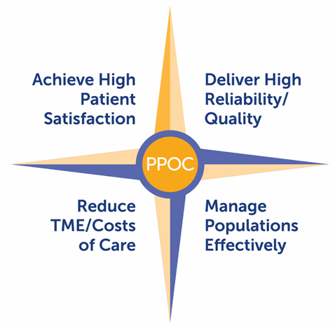
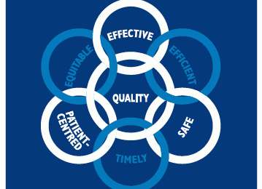
Value
What the customer is willing to pay for
Transforms a product or service
Is done right the first time
The ultimate customer in healthcare is the patient

Slide 19
It’s All About Adding Value
Patients
Employees
Organization
Quality
Meaningful
Work
Mission
Experience
Work Environment
Margin
Cost
Respect
Reputation

Slide 20
Types of Work
Value-Added Work
Activities that transform material, information, or people into something that the customer cares about
Ex. Direct patient care
Required Non-Value Added Work
No value in the customer’s eyes, but can’t be avoided
Ex. Transporting specimens to a lab, checking into a visit, regulatory tasks
Non-Value Added Work
Consumes resources and doesn’t add value
Ex. Looking for data/information, waiting, re-work

Slide 21
Pizza – What are you willing to pay for?
Waste =
Non-Value-Added =
Not Willing to Pay For ($$)
Notes:
Let’s take a step out of healthcare for a moment of time to review something close to all of our hearts: Pizza. Now, I must admit, I love Pizza – so much so that I found MUCH of this non-value added and invested in a gas powered pizza oven. This thing is insane and changes the value conversation for me when thinking about pizza.

Slide 22
Eliminate Waste, Increase Value
Observe that 2 things are ALWAYS happening
Things that should be done
Things that should not be done
Value
Non-Value
Before
After
Reduce waste
Example
Increase value
…Or
Lead Time
Value Added Work
Non Value Added Work
“It”…Either Adds Value or Does Not

Slide 23
Creating Maximum Value:
Lean Management in Healthcare
Session 1, Lesson 4
The 8 Wastes
Jonathan R Modest, MBA, MPH
Instructor

Slide 24
The 8 Wastes
D
O
W
N
Defects
Overproduction
Waiting
Not Utilizing Employees
Errors
Process or system failures, medical mistakes, misdiagnosis, hospital acquired infections
Doing more than needed
Preparing medications for a discharged patient, duplication of tests, extended hospital stays
Waiting or Delays
Sitting in waiting area, meetings held for late arrivals, wait lists, idle equipment
Ideas and skills not used
Not leveraging staff creativity and talents for work that promotes optimized operations
T
I
M
E
Transport
Inventory
Motion
Extra Processing
Movement of people or material
Transporting patients to different departments, running to gather supplies and meds
Too much material
Surplus supplies and medications, extra equipment or data, pre-printed forms
Movement by workers
Reaching or stopping for frequently used supplies and equipment, increased walking due to poor floor design
Re-dos
Needless tests, filling out different forms with same info, data entry into multiple systems
Notes:
Obtained from: https://catalyst.nejm.org/doi/full/10.1056/CAT.18.0193
Taiichi Ohno of Toyota, the originator of lean principles, described seven areas of waste that occur in every industry. (Toyota later identified the eighth waste.) It may seem counter-intuitive to apply what has worked in manufacturing in a hospital setting, but by implementing lean in healthcare and reviewing processes and systems through the lens of the eight wastes, organizations can potentially:
D: Eradicate DEFECTS to Improve Quality of Care and Increase Reimbursement: Process or system failures, medical mistakes, and misdiagnosis are examples of defect waste in healthcare. Healthcare-acquired conditions such as blood clots and infections, medication or surgical errors, avoidable readmissions, preventable allergic reactions, incomplete or erroneous medical records all illustrate defect waste in healthcare. As payers move toward pay for performance models that reward/penalize outcomes, organizations can leverage lean principles to mobilize every employee to eradicate defect waste and improve quality to positively impact the bottom line and, most importantly, to avoid mistakes.
O: Maximize Resources by Minimizing Healthcare OVERPRODUCTION: Overproduction waste entails redundancies, creating too much of something, or creating it at inappropriate times. Preparing medications for a discharged patient, duplication of tests, or extending hospital stays beyond medical necessity are all examples of overproduction that healthcare organizations can tackle.
W: Reduce WAITING / Idle Time: According to lean principles, any time patients or employees are required to stand by, waste happens. Patients sitting in waiting areas, meetings stalled for latecomers, appointment waiting lists, and idle high-tech equipment are all areas that represent opportunities for healthcare organizations to tap the creativity and imagination of their teams to reduce waste.
N: Understand how Healthcare Waste Leads to Untapped Human Potential – the Pinnacle of Waste in Healthcare (NOT UTILIZING EMPLOYEES): When workers’ time is consumed by any of the above, they are unable to use it to leverage their creativity and talents for work that promotes patient care and optimized operations. Waste in healthcare detracts from time that employees could use for educational pursuits, building relationships with patients, or implementing systems-based improvements. Adopting a lean culture not only leads to improvements in care quality and decreased cost, it also leads to improved employee morale and commitment.
T: TRANSPORTATION – Decrease the Movement of Patients, Supplies, and Equipment to Improve Patient Flow: Transportation waste in healthcare involves moving people, supplies, and medical equipment unnecessarily. Transporting patients to different departments and running around to gather supplies also increase the risk of patient or caregiver injury (defect waste) and create delays in care (waiting waste). Lean thinking can be used to analyze patient and caregiver movement through the hospital facility to save time, reduce injury, and improve patient flow.
I: Minimize INVENTORY: Inventory represents tied-up capital and storage cost. Surplus supplies and medications, superfluous equipment, extraneous data, or stockpiles of pre-printed forms all translate to inventory waste. Moreover, excessive inventory increases the risk of loss from being stolen or becoming obsolete. Employees throughout the organization can be trained to recognize excessive inventory and find novel ways to decrease it.
M: Prevent Injuries and Save Time by Reducing MOTION: Waste in motion occurs whenever hospital workers perform movement within their workspace that does not add value for patients. Reaching or stooping for frequently used supplies and equipment, increased walking due to poor building design, or non-ergonomic patient transfers between beds, wheelchairs, or operating tables are potential instances of motion waste.
E: Remove Waste from EXTRA-PROCESSING: Over-processing occurs when unnecessary work goes into treating patients. Needless tests, filling out different forms with the same information, and performing data entry in more than one system are examples. When time, effort, and resources do not add to the quality of care or improve patient outcomes, it has the potential to be changed or eliminated through lean analysis. By viewing all processes through the lens of lean healthcare, staff can help identify repetitive, redundant, or less than valuable processes to save time and money.

Slide 25


How do we identify waste?
“The actual place”
Gemba is the most important place in your organization. It is where all of the value is created
G – Genchi Gembutsu – Go and See
E – Engage
M – Muda, Mura, Muri – Discover forms of Waste
B – Be respectful, always
A – Analyze and assess the data you gathered…be sure to include the people

Slide 26
Let’s go to the GEMBA!
Identifying Waste

Slide 27
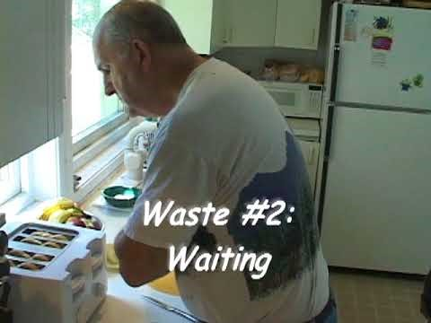
Toast Kaizen!
Notes:
https://www.gbmpstreaming.org/programs/toast-kaizen
Current state ends 7:58, target condition: 20:24

Slide 28
Waste Walk Form

Slide 29
Creating Maximum Value:
Lean Management in Healthcare
Session 2, Lesson 1
Project Management Overview and The PM Triangle
Jonathan R Modest, MBA, MPH
Instructor

Slide 30

Project Management
Notes:
https://www.youtube.com/watch?v=dQp-z4AUZ78

Slide 31
Project Management
The process of establishing, prioritizing and carrying out tasks to complete specific objectives
Involves:
  Identifying and prioritizing tasks
  Identifying and assigning resources
  In-process performance management of progress-to-outcomes
  Taking actions to ensure success

Slide 32
Project Management Triangle
Cost
Quality
Scope
Schedule

Slide 33
PM Overview: Environment
Priority
  Is this aligned with your organizational vision?
Authority
  Need to understand how much authority the PM has and then design a strategy for getting things done
Communication
  Establish your “flag pole”, your “need to know” and your communication plan

Slide 34
Enterprise Environmental Factors
People
Market
Databases
Risk Tolerance
Standards/Regulations
Culture

Slide 35
PM Overview: Challenges
Communication is 90% of a PMs job
Daily Manage
  Expectations
  Scope
  Gather Requirements
  Constraints
    Budget
    Regulatory
    Resource

Slide 36
PMP Overview: Project Lifecycle
Define/Initiate
Plan
Execute/Control
Continuous Assessment
(Risk mgmt, plan control, change mgmt)
Close out & Celebrate

Slide 37
Important Project Management Steps
Describe the Project
Assemble the Project Team
Identify Resources and Stakeholders
Construct a Gantt Chart
Develop a Timeline
Shift Resources and Assign Responsibilities
Document and Monitor Process

Slide 38
Creating Maximum Value:
Lean Management in Healthcare
Session 2, Lesson 2
Project Management Steps 1 and 2:
SIPOC Diagrams and Stages of Team Development
Jonathan R Modest, MBA, MPH
Instructor

Slide 39
Important Project Management Steps
Describe the Project
Assemble the Project Team
Identify Resources and Stakeholders
Construct a Gantt Chart
Develop a Timeline
Shift Resources and Assign Responsibilities
Document and Monitor Process

Slide 40
1. Describe the project
…in terms of overall objectives, measurements and activities, tasks or events. Also define what is not included in the scope of a project. List the major pieces or steps and people involved

Slide 41
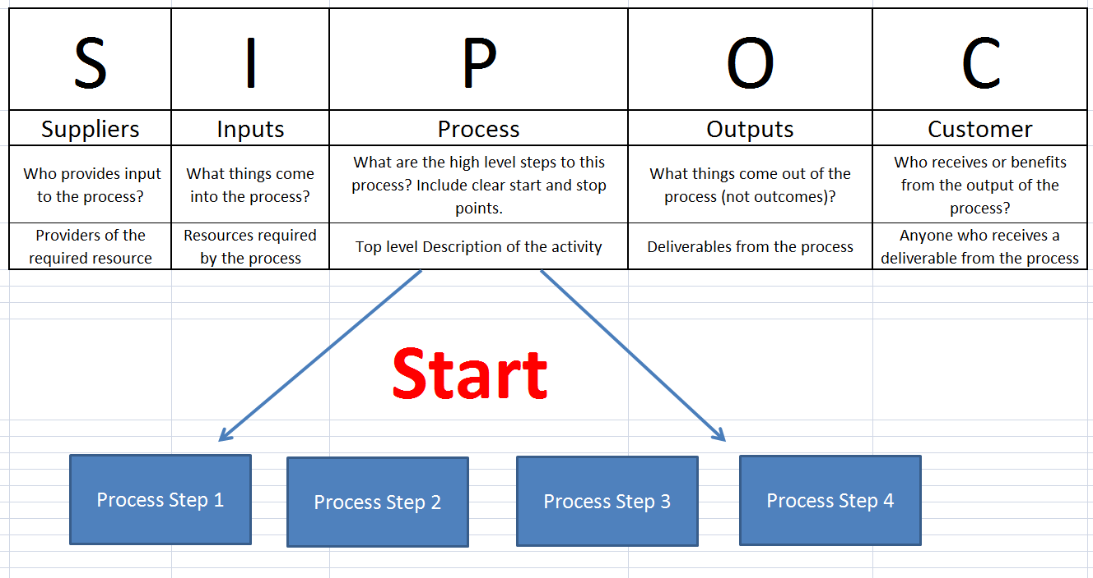
S.I.P.O.C
Purpose
To scope the project
Ensure proper SMEs for the project
To develop a preliminary understanding of the process and key metrics

Slide 42

2. Assemble the Project Team

Slide 43
Stages of Team Development
Performing
Performance
Norming
Storming
Forming
Time

Slide 44
Creating Maximum Value:
Lean Management in Healthcare
Session 2, Lesson 3
Project Management Step 3: Stakeholder Analysis
Jonathan R Modest, MBA, MPH
Instructor

Slide 45
Important Project Management Steps
Describe the Project
Assemble the Project Team
Identify Resources and Stakeholders
Construct a Gantt Chart
Develop a Timeline
Shift Resources and Assign Responsibilities
Document and Monitor Process

Slide 46

3. Identify Resources and Stakeholders

Slide 47
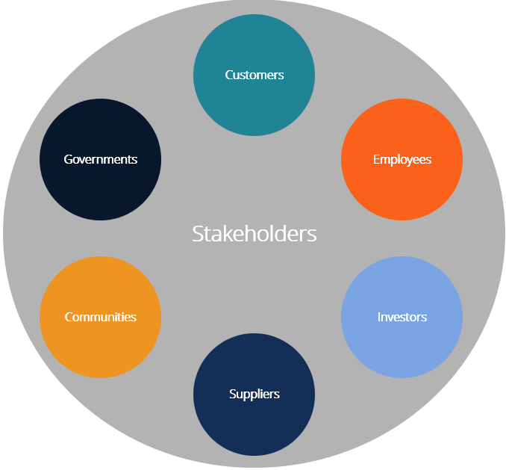
Stakeholder
A general term to describe individuals, groups, or organizations that have an interest in the project and can mobilize resources to affect its outcome in some way

Slide 48
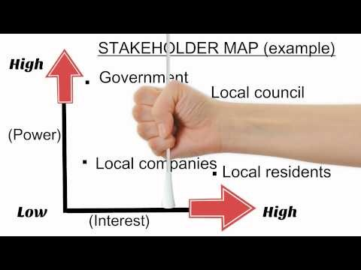
Stakeholder Analysis/Mapping
Notes:
https://www.youtube.com/watch?v=bOIT1GKVMd8

Slide 49
Stakeholder Roles
Special efforts to meet needs and ensure participation
(Consult)
Closely involved throughout the project
(Partner)
Power
Not closely involved; information sharing strategies aimed at general public
(Monitor)
Not target of project, but may hinder it
(Inform)
Interest

Slide 50
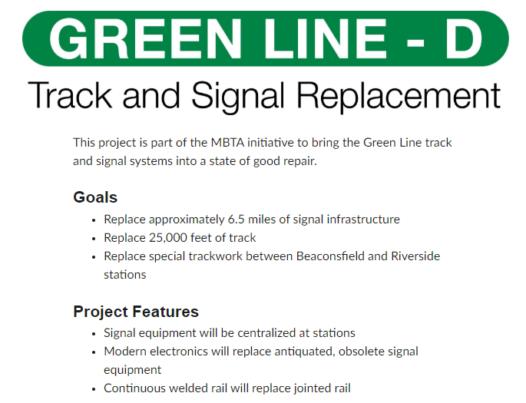
Notes:
Breakout into small groups and Name potential stakeholders of this project – and where they might fall in the Stakeholder Grid

Slide 51
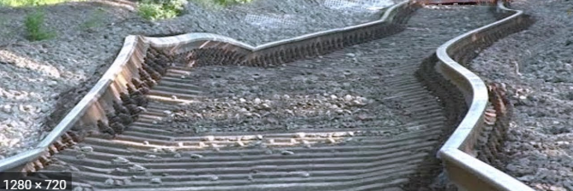
Class question:
Who are some stakeholders in the Green Line Track Replacement Project?

Slide 52
Creating Maximum Value:
Lean Management in Healthcare
Session 2, Lesson 4
Project Management Step 4 and 5:
Gantt Charts and Project Timelines
Jonathan R Modest, MBA, MPH
Instructor

Slide 53
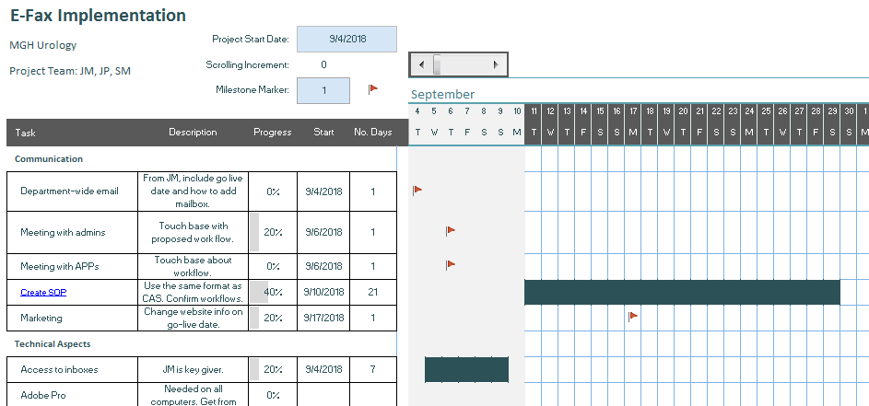
4. Construct a Gantt Chart

Slide 54

Too Many Pumpkins…

Slide 55
Gantt Chart
Outlines all of the tasks (and their order) involved in a project against a timeline. This provides an overview of the project, all of the tasks and when they need to be completed
Identifies key dates/deliverables
Identifies dependent tasks and potential bottlenecks

Slide 56
Gantt Chart Steps
Identify essential tasks
  List all activities needed for the project
  Estimate start date and duration
Identify task relationships
  Some tasks will need to be completed before you start the next one
  Some tasks cannot end until the preceding one has ended
Input activities into software or a template
  Excel, Microsoft Project, etc
Chart progress

Slide 57
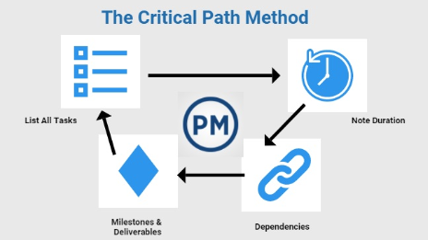
Critical Path
Sequence or stages determining the minimum amount of time needed for a project

Slide 58
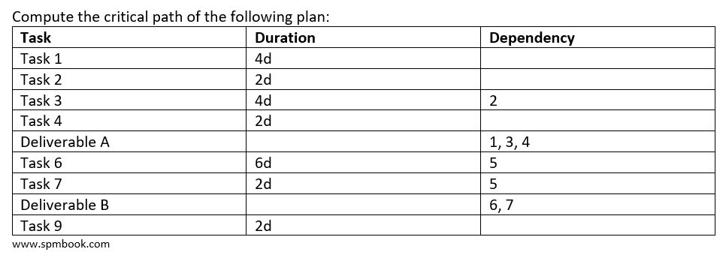
Critical Path/Project Duration Live Exercise

Slide 59
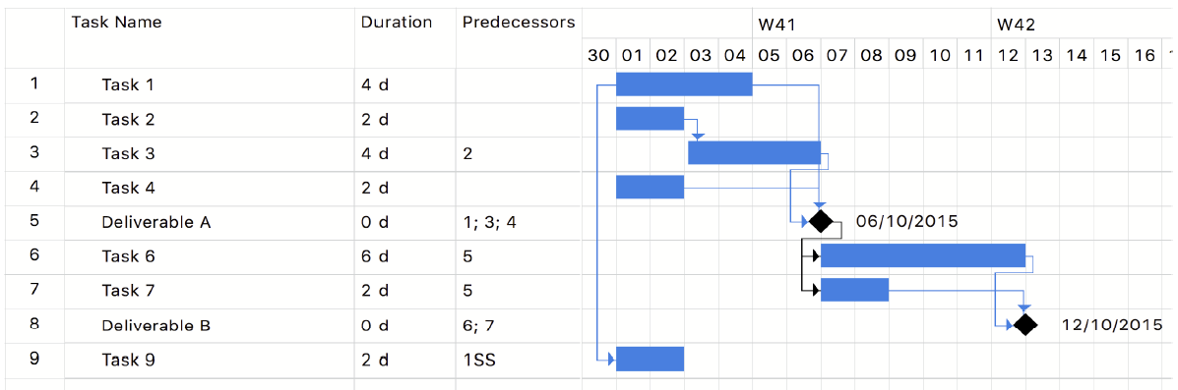
The Critical Path

Slide 60
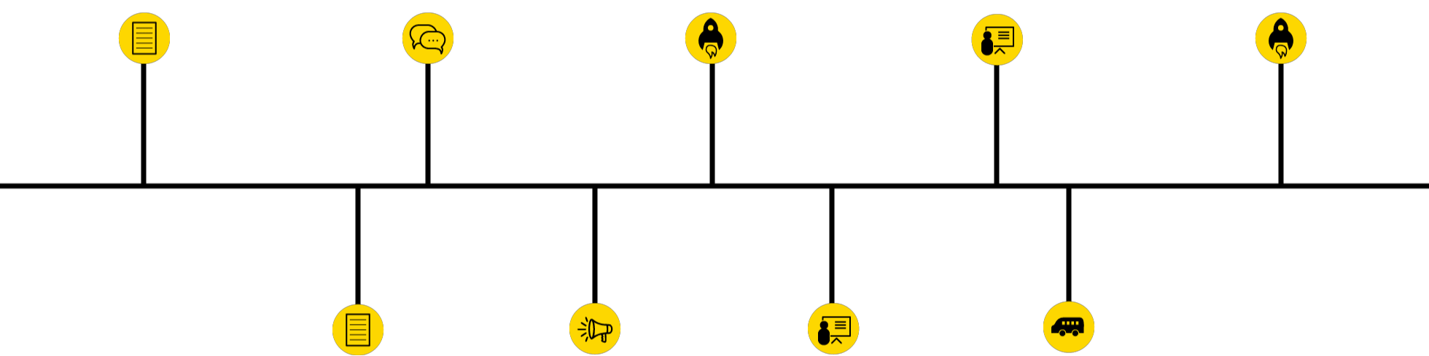
5. Develop a Timeline

Slide 61
Creating Maximum Value:
Lean Management in Healthcare
Session 2, Lesson 5
Project Management Step 6 and 7: RACI Charts
Jonathan R Modest, MBA, MPH
Instructor

Slide 62

6. Shift Resources and Assign Responsibilities

Slide 63
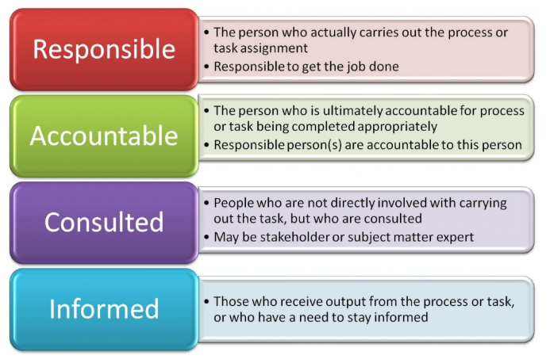
Identify Roles and Responsibilities

Slide 64
Steps in a RACI Process
Identify all of the processes/ activities involved and list them down the left hand side of the chart.
Identify all the roles and list them along the top of the chart.
Complete the cells of the chart: identify who has the R,A,C,I for each process.
Analyze gaps in chart
Functional Roles
Activities
A
C
I
R
C
I
C
C
I
R
A
R
A
I
A
C
A
I
R
C
A
C
R
I

Slide 65
Analyzing a RACI Chart
Vertical Analysis
  Many R’s
  No empty spaces
  No R’s or A’s
  Too many A’s
  Qualifications
Functional Roles
Activities
A
C
I
R
C
I
C
C
I
R
A
R
A
I
A
C
A
I
R
C
A
C
R
I
Too many "R's" could signal a work over-load situation.
https://www.projectsmart.co.uk/how-to-do-raci-charting-and-analysis.php
Notes:
Vertical Analysis
A lot of R's: Is it possible for the individual(s) to stay on top of so much? Can the activity be broken into smaller, more manageable chunks?
No empty spaces: Does the individual(s) need to be involved in so many activities? Are they a 'gatekeeper' or could management by exception principles be used? Can consulted be (R)educed to (I)nformed, or can things be left to the individual's discretion when something needs particular attention?
No R's or A's: Should this functional role be eliminated or have processes changed to an extent where resources could be reassigned?
Too many A's: Does a proper 'segregation of duties' exists? Should other groups be accountable for some of these activities to ensure checks and balances and accurate decision making throughout the process? Is this a 'bottleneck' in the process. Is everyone waiting for decisions or direction?
Qualifications: Does the level of the person fit the requirement of this role? Are too many senior personnel involved for routine decision making that could be deployed downwards?

Slide 66
Analyzing a RACI Chart
Horizontal Analysis
  One R per row
  Too many A’s
  Many C’s
  Many I’s
Functional Roles
Activities
A
C
I
R
C
I
C
C
I
R
A
R
A
I
A
C
A
I
R
C
A
C
R
I
https://www.projectsmart.co.uk/how-to-do-raci-charting-and-analysis.php
Notes:
Horizontal Analysis
No R's: Who is doing the job and getting things done? Are there too many roles waiting to be approved, be consulted or informed. Whose role is it to take the initiative?
Too many R's: Is this a sign of 'over the wall' activities?
No A's: Why not? There must be an 'A.' someone must be accountable for the thing happening - the buck stops with this person.
Too many A's: Is there confusion with too many fingers in the pie? It can also create confusion because every person with accountability feels they have final say on how the work should be done.
Too few A's and R's: The process may slow down while the activity is performed or the procedure may be outdated and can be streamlined if not needed.
Every box filled in: Do all the functional roles really need to be consulted? Are there justifiable benefits in consulting all the roles or is this just covering all the bases?
A lot of C's: Do all the roles need to be routinely informed or only in exceptional circumstances? Too many in the loop can slow the process down.
A lot of I's: If too many people are involved, usually too many C's and I's, it can dramatically slow things down.

Slide 67

7. Document and Monitor Process

Slide 68
Creating Maximum Value:
Lean Management in Healthcare
Session 3, Lesson 1
Introduction to Problem Solving
Jonathan R Modest, MBA, MPH
Instructor

Slide 69
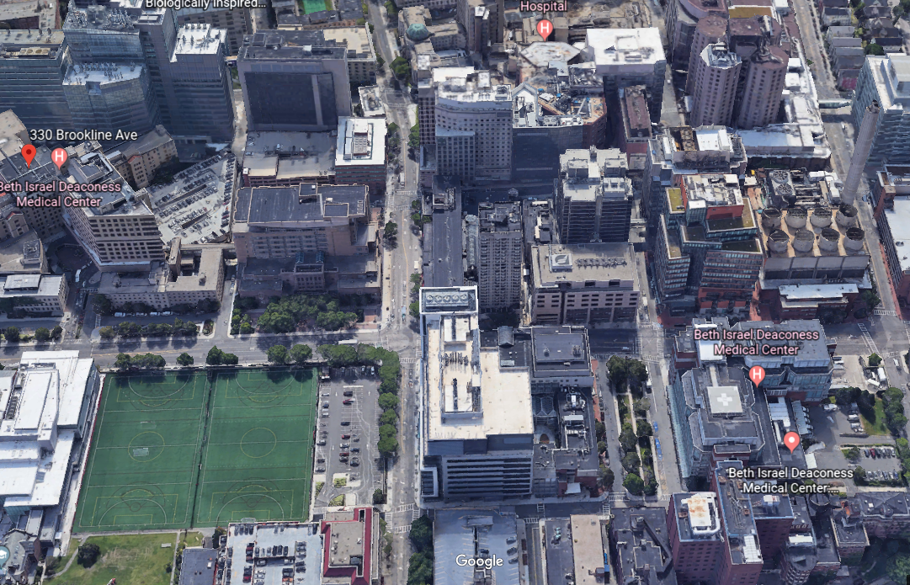

What is a “Problem”
Gap =
Problem/
Opportunity

Slide 70
How can we solve problems?
Teach Staff to recognize waste
Staff must have a way to communicate the problems they are encountering
Problems need to be prioritized against the goals of the organization
Staff should be able to work on solving the problems constructively, using daily experiments, or PDSA cycles
Items being worked on should be communicated

Slide 71

Focus on finding a solution
A problem is a gap between:
Current condition: what is actually happening and
Target or ideal condition: what should be happening
Notes:
https://www.youtube.com/watch?v=VrSUe_m19FY

Slide 72
Problem Solving
Initial perception of problem
Grasp the situation
What is the actual problem in performance?
Clarify the problem
Go to the Gemba and understand the
way the work is done
Problem breakdown
Go to the gemba, get the facts first-hand, analyze them thoroughly and objectively
Focus on the process
Be Respectful
Blame the process, not the person. Where did the process fail?
Determine
Root
Cause
Cause investigation
Determine the root cause of why the problem is occurring.
72

Slide 73
Multiple Problem Solving Methods
Solution
Known
Unknown
Known
PDSA
Kaizen
(cause is known or could easily be identified, i.e. 5 why’s)
Cause
Firefighting
A3 Problem Solving
Unknown

Slide 74
Kaizen
“… a system of continuous improvement in quality, technology, processes, company culture, productivity, safety and leadership that involves every employee and the identification and elimination of waste.”
Literal Translation: “to become good through change”
It is a Daily Process of improving at the front line
In a kaizen “event”, we know the problems and root causes, but are not sure yet of the best countermeasures. We figure that out, and implement by the end of the event.

Slide 75
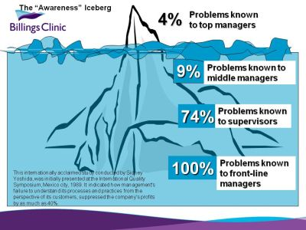
Solving Problems Below the Surface
What is unseen and unknown may be hurting us. Let’s all surface the problems, and offer ideas that might solve them.

Slide 76
Organizational Problems
Can be global (Institutional level or broader) - BIDMC ED is on the opposite side of Brookline Ave from its intensive care units
Can be local - The MGH Department of Urology has a 31.6 day average wait to see new patients
As you develop your own problem statements, consider breaking it down into multiple challenges and reframe as a smaller A3

Slide 77
How can we harness and solve problems?
Teach everyone to recognize waste
Everyone must have a way to communicate the problems they are encountering
Problems need to be prioritized against the goals of the organization
Everyone should be able to work on solving the problems constructively
Items being worked on should be communicated

Slide 78
Direct Observation
To see the current reality, you need to observe and go to the gemba
Deep understanding of the current reality at the source of the process
  How activities are performed
  How customers and suppliers are connected
  The flow of information, material and people
Beware of “confirmation bias” – don’t just look for what you expect to see!

Slide 79

Monkey Business!

Slide 80
Create a New Lens
Away from the gemba
At the gemba
Assumption of what happens
Not all stakeholders are involved
Limited information
Lens: Data and second hand information from reports, people and materials
Walk the area, be at the point of activity
Create a common view
Information at the source
No guessing!
Lens: Watch the activities, see the people and process connections and how information flows between people and systems

Slide 81
Creating Maximum Value:
Lean Management in Healthcare
Session 3, Lesson 2
The A3
Jonathan R Modest, MBA, MPH
Instructor

Slide 82
Multiple Problem Solving Methods
Solution
Known
Unknown
Known
PDSA
Kaizen
(cause is known or could easily be identified, i.e. 5 why’s)
Cause
Firefighting
A3 Problem Solving
Unknown

Slide 83
A3: The Basic Problem Solving and Communication Tool
Designed to help “tell the story” in a logical and visual way
Acts as a road map for continuous improvement and problem solving initiatives
Refers to 11”x17” paper

Slide 84
A3 Sections
Problem Statement
Scope (In/Out)
Background/Current State
Problem/Root Cause Analysis
Goals
Countermeasures (Plan)
Implementation (Do)
Results/Conclusion (Study)
Follow-Up/Actions (Act)

Slide 85
A3 Report
Enhanced
PDSA
Problem Definition
Countermeasures
PLAN
+
Plan
ACT
DO
Root Cause(s)
STUDY
(or Check)
Results
Enhances “Plan” in PDSA with better understanding of the problem and causes, to generate better countermeasures

Slide 86
PDSA Supports Small, Incremental Changes (Kaizen)
Created by Shewhart in the 1930s
Popularized by Deming first in Japan
in the 1950s
Scientific method
At the core of all quality systems
The foundation for the A3

Slide 87
PDSA Cycle
Act
What changes need to be made to the next cycle?
Plan
Set improvement goals
Do
Carry out the plan
Study
Fully analyze data
Predict what will happen
Plan the cycle (who, where, what and how)
Decide what data to gather
Document any observations and problems encountered
Gather Data
Compare data to predictions
Examine Learning
If no changes, roll out the improvement
Cycling through Plan, Do, Study, and Act until desired result is achieved, is essential to improving

Slide 88
A3 Template
PROBLEM SOLVING A3 | TITLE: | Last Saved Date:
TEAM MEMBERS:
PROBLEM STATEMENT:
SCOPE (IN/OUT):
BACKGROUND/CURRENT CONDITIONS:
ROOT CAUSE ANALYSIS:
GOALS:
COUNTERMEASURES (PLAN):
IMPLEMENTATION (DO):
RESULTS /CONCLUSIONS (STUDY):
FOLLOW-UP/ ACTIONS (ACT):

Slide 89

A living, breathing document

Slide 90
A3 Team Members
A3 Owner
Ultimately responsible, owns the problem or process where the problem occurs Everyone must have a way to communicate the problems they are encountering
A3 Lead
Accountable for leading a team through the scientific problem solving process
A3 Team Members
People who work as part of the process your A3 is investigating. Crucial to overall success. They must be active champions of process change and continuous improvement

Slide 91
Creating Maximum Value:
Lean Management in Healthcare
Session 3, Lesson 3
A3: The Problem Statement
Jonathan R Modest, MBA, MPH
Instructor

Slide 92
A3 Template
PROBLEM SOLVING A3 | TITLE: | Last Saved Date:
TEAM MEMBERS:
PROBLEM STATEMENT:
SCOPE (IN/OUT):
BACKGROUND/CURRENT CONDITIONS:
ROOT CAUSE ANALYSIS:
GOALS:
COUNTERMEASURES (PLAN):
IMPLEMENTATION (DO):
RESULTS /CONCLUSIONS (STUDY):
FOLLOW-UP/ ACTIONS (ACT):

Slide 93
Developing a Problem Statement
Must Haves
Wants
What
The problem statement includes what is being affected.
Where
The problem statement includes where the problem is occurring (space, location, or the point of cause in the process).
When
A pattern of occurrence over time
Specific dates and times
States when the problem was discovered
Who
Who is being affected by this problem (titles or responsibilities)?
How often/How many
Quantifies the actual number of occurrences.
Consequences
Actual or potential consequences if the problem is not fixed (impact on quality, cost, customers, morale, etc.).

Slide 94

Essential but Challenging
Distractions can come from a variety of sources!
Symptoms associated with the problem add confusion when trying to describe it (states what, not why)
Solutions, while at the top of everyone’s mind, should be avoided until you have full understanding
Search for causes/root causes should be avoided until the appropriate point in the project
Do not assign blame
www.isixsigma.com

Slide 95

Don’t Whiff on the Problem!
Notes:
https://www.youtube.com/watch?v=-D5eYZFcX2Q&t=2s – 14 seconds

Slide 96
Contents of a Well-Defined Problem Statement
Gap: Identify the gap (pain) that exists
Timeframe, location and trend: Describe when and where the problem was first observed and what kind of trend it is following
Impact: Quantify the gap (cost, time, quality, environmental, personal, etc)
Importance: To the organization, the individual, etc to better understand the urgency
Gains alignment and ensures success
Agreed upon by the core team and leadership early
in the process
Refined to reflect what you learn

Slide 97
Which one is better?
Our department has a problem with the number of wait days for a patients who want to scheduled appointment. Patients are mad and want to be seen sooner
New patient access to our Boston clinic location averages 32.4 days, causing patients to seek care elsewhere and preventing us from caring for patients in a timely manner

Slide 98
Which one is better?
We are throwing away too many supplies because they are expired
Supply inventory levels in the hospital’s operating rooms are not being used fast enough as well as consuming space and resulting in wasted product. We have thrown away $500K in supplies in the last 6 months

Slide 99
Examples of Problem Statements
PROBLEM STATEMENT: Over the last 16 months, Hospital W averaged 164 ED boarders per month. Patients who board in the Emergency Department are subject to an increased rate of mortality and decreased satisfaction in their care.
PROBLEM STATEMENT: At Hospital X, high abandonment rate (averaging 31.9% weekly over the past 4.5 months) of patients and providers calling the Cardiology clinic number (3,452), is causing patient and staff dissatisfaction.
PROBLEM STATEMENT: At Hospital Y, 70% of all first dose antibiotics administrations to NICU infants are taking >1 hour from order to administration, which delays timely sepsis treatment.

Slide 100
Creating Maximum Value:
Lean Management in Healthcare
Session 3, Lesson 4
A3: Scope and Current Conditions
Jonathan R Modest, MBA, MPH
Instructor

Slide 101
A3 Template
PROBLEM SOLVING A3 | TITLE: | Last Saved Date:
TEAM MEMBERS:
PROBLEM STATEMENT:
SCOPE (IN/OUT):
BACKGROUND/CURRENT CONDITIONS:
ROOT CAUSE ANALYSIS:
GOALS:
COUNTERMEASURES (PLAN):
IMPLEMENTATION (DO):
RESULTS /CONCLUSIONS (STUDY):
FOLLOW-UP/ ACTIONS (ACT):

Slide 102
Scope
What’s in scope? What’s out of scope?
  Pediatric vs. Adult
  Inpatient vs. Outpatient
  One campus, multiple campuses
  Process start → finish
Example:
  SCOPE (IN/OUT):
        In: Boston campus, Department of Urology
        Out: Inpatient floor
        Start: Patient seen
        End: Treatment complete

Slide 103
Background/Current Conditions
Describe what is actually happening
Identify and quantify waste & value
Not just “what”, but
  How much/How often (Is it a trend or one time event?)
  Where (ex: University, Memorial, 4th floor, NICU, etc.)
  When (ex: all the time, certain days of the week or time of day)
  Who (Who is involved or impacted)
  Which (ex: certain equipment, supplies, medications)
  How (how does the process work?)
  Consider safety, quality, compliance, existing policies, regulations, and laws
Notes:
How: Will explore process mapping in 2 weeks

Slide 104

Defining metrics and gathering data is essential to defining the current state!

Slide 105
Data vs. Metrics
Data
is a collection of facts, such as values or measurements
Individual measurements
Data can be numbers, words, measurements, observations, or descriptions
Example
  Time stamps of patient encounters
ED registration time
Decision to admit to inpatient time
Discharge time
  Metrics
  are used to determine where a process stands in relation to its goals and to evaluate the effects of a process change
Example
Calculations from the individual measurements
Number of ED Boarders
Median Length of stay
Average DC time

Slide 106
Other Tools for Current State
Later this semester, we will explore
  Process Maps
  Value Stream Maps
  Pictures
  Layouts
  Spaghetti Diagrams
  Data analysis

Slide 107
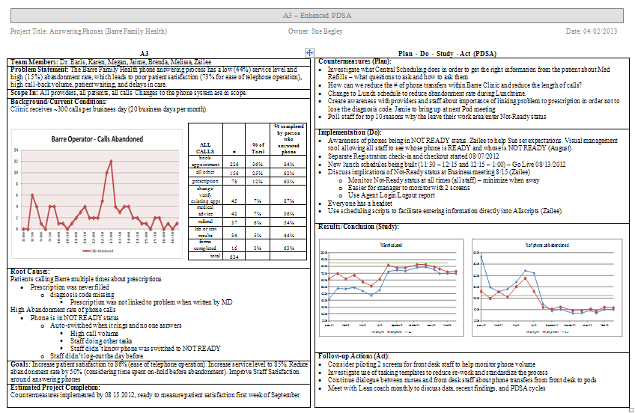
A3 Example

Slide 108
Creating Maximum Value:
Lean Management in Healthcare
Session 4: TAKT Time and Other Operational Statistics
Jonathan R Modest, MBA, MPH
Instructor

Slide 109

TAKT Time
The pace at which the work needs to be done in order to meet demand

Slide 110
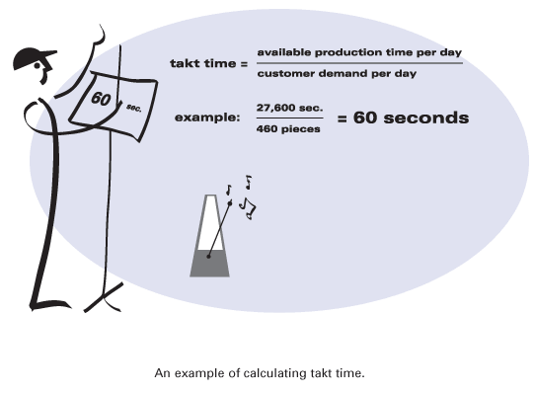
TAKT Time
Defines the pace of repetitive customer demand – presented in units of time and is calculated by:
Determining your demand per shift or day
Determining your available time (excluding breaks, meeting times)
Calculate your Takt time (available time/demand)

Slide 111

TAKT, Cycle and Lead Time
Notes:
https://www.youtube.com/watch?v=isu6MG3v0-s

Slide 112

But Healthcare isn’t Manufacturing!

Slide 113
TAKT Time in Healthcare
In complex organizations, TAKT Time becomes fundamental to resource planning and ensuring you are staffed to meet demand
Helps ensure leaders are not demanding the impossible or letting skills go to waste
Helps define the gap between current state conditions and expected based on patient demand

Slide 114
Asynchronous Learning - Calculate TAKT Time
A sub-specialty clinic is open from 8:00am to 4:30pm Monday through Friday
The number of scheduled patients per day this coming week is as follows:
  Monday: 259
  Tuesday: 236
  Wednesday: 187
  Thursday: 164 (clinic does not open until 10:00am)
  Friday: 120
The clinic has a centralized check-in team
Calculate the check-in TAKT time by day of week

Slide 115
Asynchronous Learning - Calculate TAKT Time
A sub-specialty clinic is open from 8:00am to 4:30pm Monday through Friday
The number of scheduled patients per day this coming week is as follows:
  Monday: 1.97 mins
  Tuesday: 2.16 mins
  Wednesday: 2.73 mins
  Thursday: 2.38 mins (clinic does not open until 10:00am)
  Friday: 4.25 mins

Slide 116
Creating Maximum Value:
Lean Management in Healthcare
Session 5, Lesson 1
Process Mapping
Jonathan R Modest, MBA, MPH
Instructor

Slide 117
A3 Template
PROBLEM SOLVING A3 | TITLE: | Last Saved Date:
TEAM MEMBERS:
PROBLEM STATEMENT:
SCOPE (IN/OUT):
BACKGROUND/CURRENT CONDITIONS:
ROOT CAUSE ANALYSIS:
GOALS:
COUNTERMEASURES (PLAN):
IMPLEMENTATION (DO):
RESULTS /CONCLUSIONS (STUDY):
FOLLOW-UP/ ACTIONS (ACT):

Slide 118

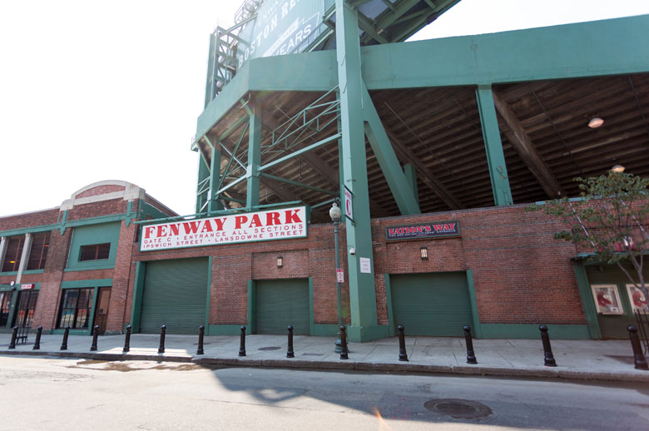
Value Stream and Process Mapping
Value Stream Mapping
Process Mapping
10,000 ft level
Considers the entire value stream
Identifies non-value added steps
Enables long-term strategic planning (typically one year or more)
“Ground level”
Very detailed, every step and decision documented
Improvements are usually small but easy to implement
Enables short term tactical planning

Slide 119

Process Mapping
Use to gain consensus, to show waste and problems associated with your overall problem statement
Enhances problem solving
Improves decision making
Involves the people doing the work
Illustrates the current state/condition

Slide 120
Process Mapping
Process mapping is a method for creating a diagram that uses graphic symbols to show the steps and the flow of a process. Other commonly used names for a process map are flow diagram and flow chart.
Quality By Design: A Clinical Microsystems Approach
E. Nelson, P. Batalden, M. Godfrey

Slide 121
Use it to Assess!
Creates visual clarity: a picture is worth a thousand words
Engages professionals in the practice in a shared understanding of work and roles in care
Creates understanding about just what work is being done by team members in relationship to
  Each other
  The purpose of the work

Slide 122
Use it to Assess!
Allows easy spotting of:
    Potential gaps
    Delays
    Duplication
    Rework in progress
Supports the needed changes: our processes must change or evolve in specific ways if we are to achieve different or better outcomes

Slide 123
What is a Process?
A process in a clinical setting is a series of related work activities that together produce care for patients and their families
For example:
  Appointment booking
  Refilling prescriptions
  Managing kids with asthma

Slide 124
Common symbols
Process beginning or end
Waits and delays
Process flow direction
Activity step
Connector
(for example, to another page)
Decision points
“Don’t know”

Slide 125
How to Process Map
Step One:
Understand what you are attempting to accomplish
  This is the AIM of your performance improvement

Slide 126
How to Process Map
Step Two:
Define the 5 Ps in your office
    Purpose
    Patients
    Professionals
    Processes
    Patterns

Slide 127
How to Process Map
Step Three:
Observe / ask the professionals to define their work
Step Four:
Sequence the work as you understand its order
Step Five:
Use the symbols to create the flow chart

Slide 128
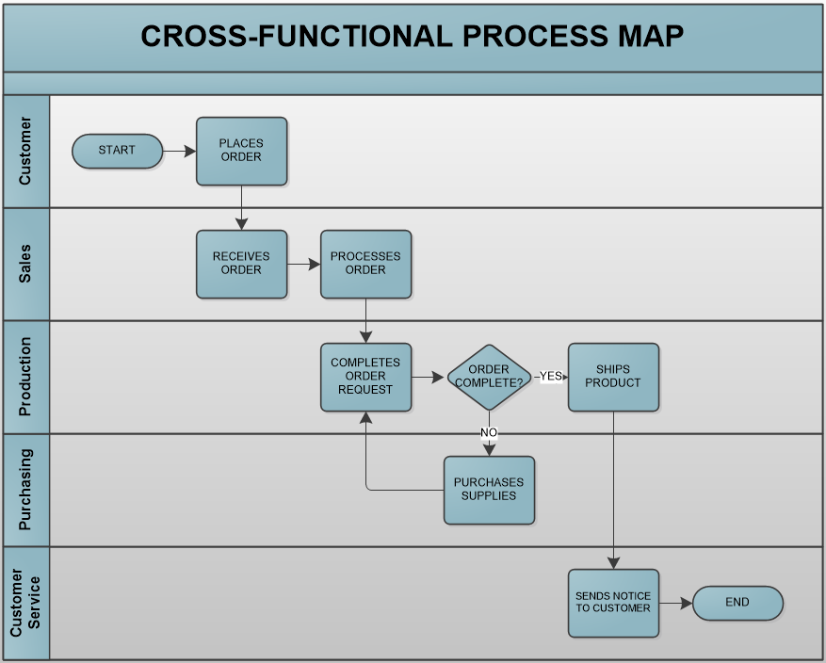
Cross-Functional Process Maps

Slide 129
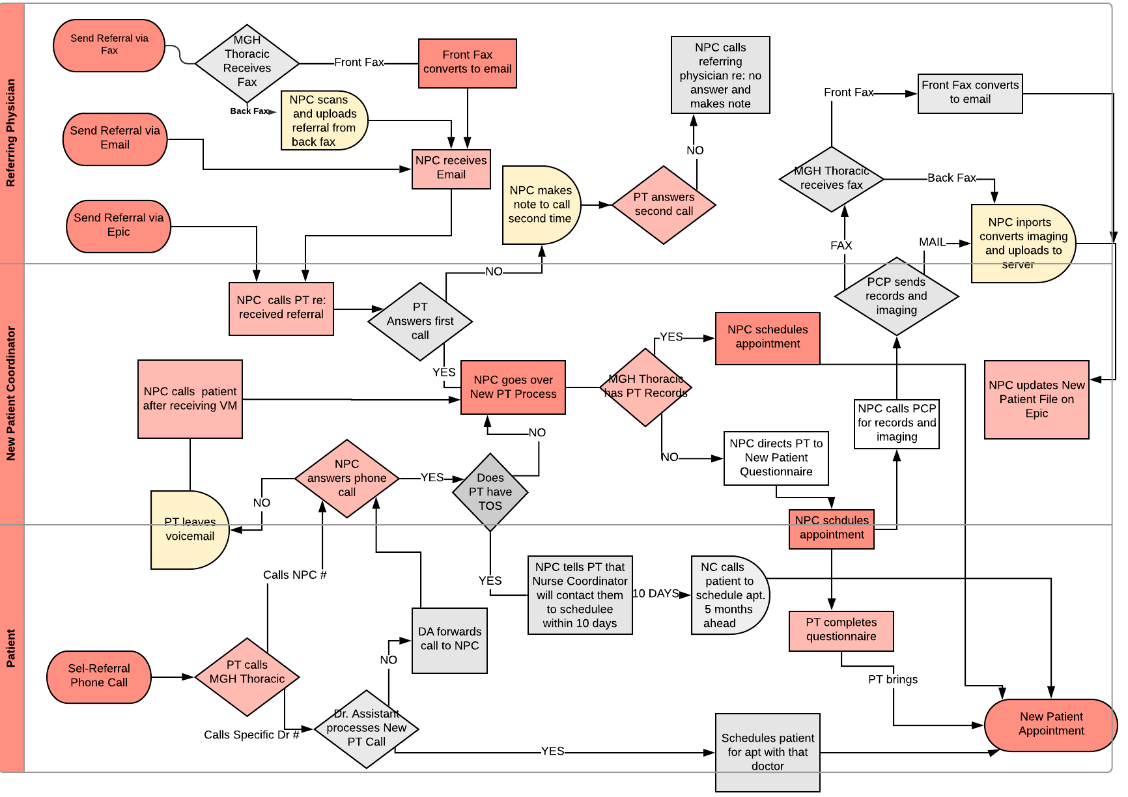
Cross-Functional Process Maps

Slide 130
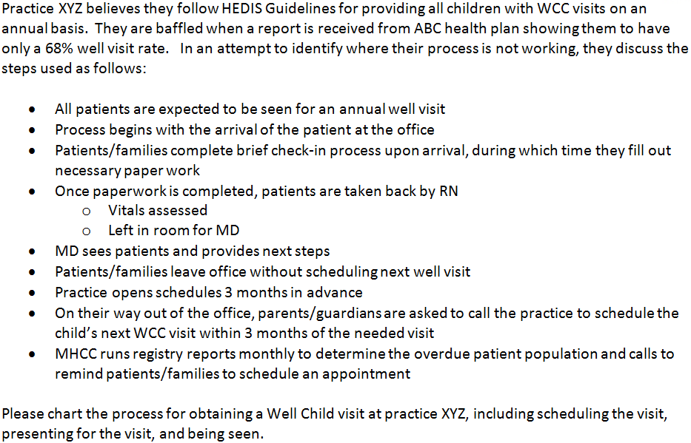
Asynchronous Learning Scenario

Slide 131
Creating Maximum Value:
Lean Management in Healthcare
Session 5, Lesson 2
Process Map Example
Jonathan R Modest, MBA, MPH
Instructor

Slide 132
Asynchronous Learning Scenario

Slide 133
Pt arrives
Pt/family checks-in
Completes paperwork
Waits in waiting room
Roomed by RN
Schedules next visit?
Visit complete
MD sees patient and provides next steps
Waits for MD
Vitals assessed
Y
N
Coordinator runs registry report
Coordinator calls patient and schedules visit

Slide 134
Creating Maximum Value:
Lean Management in Healthcare
Session 6, Lesson 1
Value Stream Mapping
Jonathan R Modest, MBA, MPH
Instructor

Slide 135
A3 Template
PROBLEM SOLVING A3 | TITLE: | Last Saved Date:
TEAM MEMBERS:
PROBLEM STATEMENT:
SCOPE (IN/OUT):
BACKGROUND/CURRENT CONDITIONS:
ROOT CAUSE ANALYSIS:
GOALS:
COUNTERMEASURES (PLAN):
IMPLEMENTATION (DO):
RESULTS /CONCLUSIONS (STUDY):
FOLLOW-UP/ ACTIONS (ACT):

Slide 136
Value Stream and Process Mapping
Value Stream Mapping
Process Mapping
10,000 ft level
Considers the entire value stream
Identifies non-value added steps
Enables long-term strategic planning (typically one year or more)
“Ground level”
Very detailed, every step and decision documented
Improvements are usually small but easy to implement
Enables short term tactical planning

Slide 137
Value Stream Mapping
A visual representation of the material, work, and information flow, as well as the queue times between processes for a specific customer demand
A very powerful tool that does an excellent job identifying wastes

Slide 138
Current State VSM
Scope
Map steps in the process using these typical
process step data:
Cycle Time (C/T) :Time elapses between one part coming off the process to the next part coming off in seconds
Changeover time (C/O) :To switch from caring for one patient type to another
Number of People: Required to operate the process
Available working time:
Lead time: The time it takes one piece to move all the way through a process or value stream from start to finish.
Value-Creating Time or Value Added Time (VCT, VA): Time that actually transforms a product or service in a way that the customer is willing to pay for
% Complete and accurate
Identify waste: (DOWNTIME)
Current State Map
Ideal State
Future State
Map
Implementation
Plan
A3 Problem Solving

Slide 139
Value Stream Mapping: Ground Rules
Lead with Patient Centered Care principles; in the VSM event and on the map
We are all in this together; ask how to improve, not who to blame; focus on the process not people
All Titles are “checked” at the door
Target excellence, not perfection
Don’t get stuck in the weeds (minute detail)
Look at the big picture (whole process)
Expose problems; wisdom arises from confronting problems
Avoid negative words such as “we can’t”, use “yes, if….”
Ask “Why” until you find the root cause
Everyone contributes and is engaged; listen/learn from the people who do the work; No sidebar conversations
Be respectful, minimize cell phone use, be on time
Have Fun!

Slide 140
Steps to VSM
Identify the value stream
Identify start and stop points
Fill in high level processes
Fill in sub-processes
Display informational and material flows
Categorize as value-added/non-value added
Label waste in the value stream

Slide 141
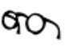
Current State VSM Symbols
Wait/
Delay
Process Step
Go See
Who:
When:
Where:
How:
Patient
Material or patient Flow
UDEs
Input
Task
Output
Task
Conversation Information Flow
Timeline –
Up – Process Time
Down – Wait Time

Slide 142
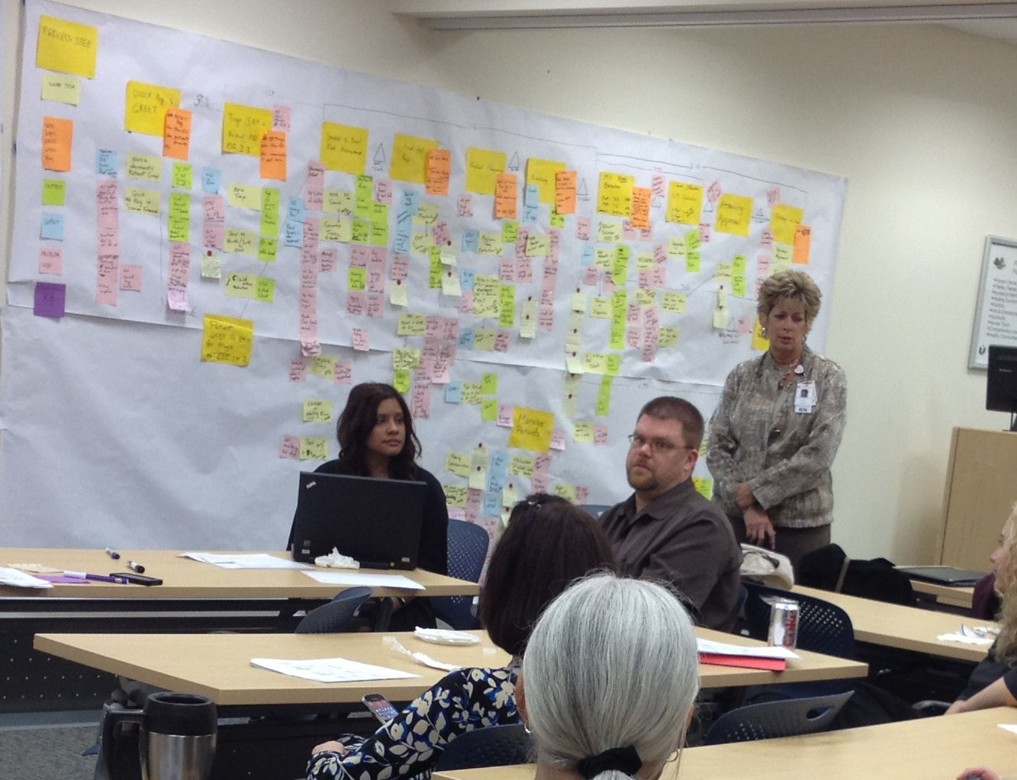
Current State Map Example

Slide 143
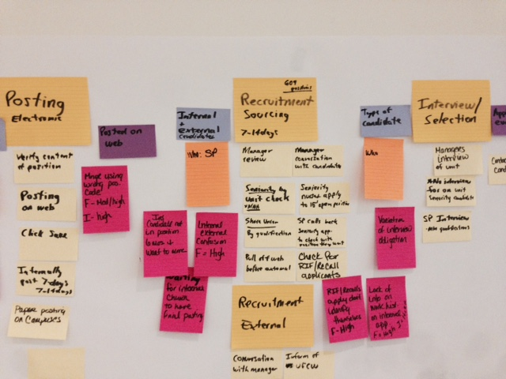
Example – Internal Hiring Process
Process Step
Input
Input
Output
Task
UDE/Waste

Slide 144
Example – Internal Hiring Process
Value Stream →
Value Stream →
Value Stream →
Process Map
Process Map
Process Map

Slide 145
Creating the Current State VSM
Begin with the value added steps in mind – regular day
  Patient arrives…what happens? Who greets them? What does that staff member do?
  Do any Undesirable effects occur?
  Continue on, encourage audience to share frustrations and perspective on their work, capture with sticky notes, stay in scope
Note any wastes in the process as UDE’s under the process step
Measure or estimate the wait times between each step, length of each process step (cycle time), and draw into map and on sticky notes
Notes:
The value added steps are those that the customer will pay for.
Many times in the hospital, the Value stream follows the patient.
However, the customers of other departments may be other areas or the hospital or other staff members. Each of these areas affects the patient in some way as well.

Slide 146
Detailed Steps
Use icons to draw a shell of the current state, listing main processes, customers and suppliers (internal and external)
Go to the gemba, beginning with the most downstream process and walk the flow in revers in order to collect attributes (ie cycle times, defects, etc) related to the value stream
Determine the amount of time between processes
Determine the quantity of work that arrives at each process (ie # of reports, labs, customers, interruptions per hour

Slide 147
Detailed Steps Cont’d
Determine what is done with the work after the process has been completed. What is the next process? Does anything special need to be done prior to the work arriving at the next process?
List all process attributes on current state map.
Draw all forms of communication, electronic and/or manual
Sum the process cycle times within the process box
Compile a step graph at the bottom of the value stream map displaying total cycle time for each process, including queue/wait/delay times

Slide 148
Guidance on UDEs
Prioritize UDEs through voting
  FREQUENCY: 1 (Low), 2 (low/med), 3 (medium), 4 (med/high), 5 (high)
  IMPACT: 1 (Low), 2 (low/med), 3 (medium), 4 (med/high), 5 (high)
Identify when an UDE may require deeper investigation (root cause analysis)
  Situations with: Lots of variation, long wait times, or major errors are triggers a RCA may be required
Complete root cause analysis as time allows
  5 WHYs (preferred)
  Fishbone (as required)
Notes:
Many times there are 50-80 UDEs that you as the facilitator (along with the group) will need to grasp. In order to help with this prioritize the UDE’s along the way.
Also, sometime UDEs are root causes and sometimes they are actually the negatives effects or symptoms of root causes.

Slide 149
Current State Re-Cap
Once mapping is complete, take a step back and review the entire process with the group
  Is this representative of the process?
  Are we missing anything?
Sum the value added time and total process time
Request data collection around the major wastes in the process
It is ok to surface problems (U.D.E.’s, D.O.W.N.T.I.M.E.)
Prior to Future State
  The facilitator should brainstorm on the best ways to lead the group through the future state

Slide 150
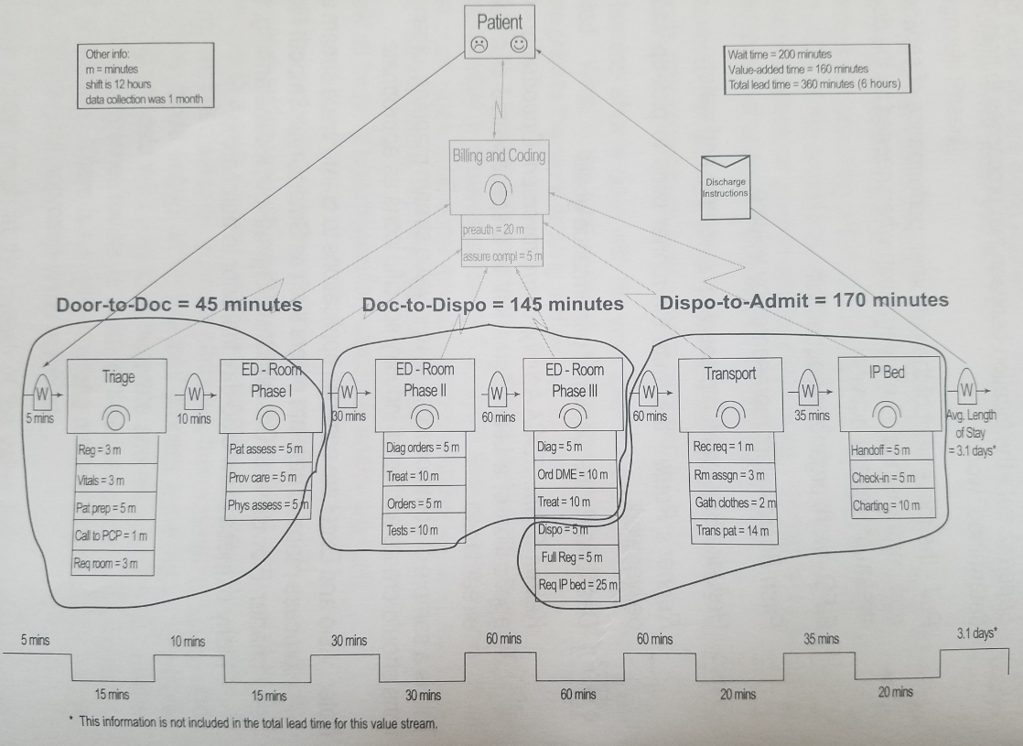
Example: ED Arrival to Inpatient Bed

Slide 151
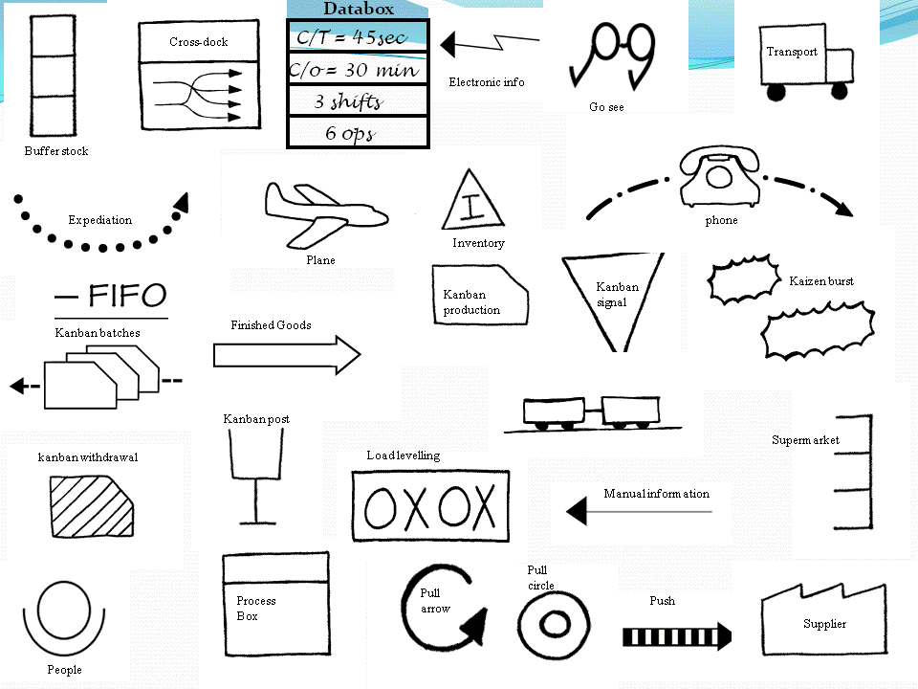
Common Symbols

Slide 152
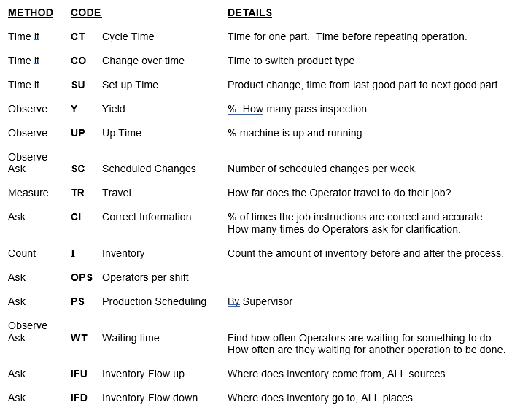

Slide 153
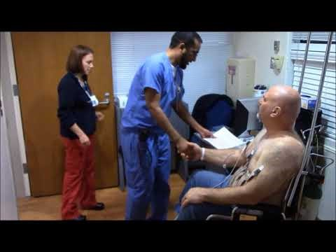
Asynchronous Learning- STEMI to Balloon Time

Slide 154
STEMI to Balloon Time
Appleton Medical Center
A triage nurse evaluated the patient, took vital signs- blood pressure, pulse, and asked questions.
That nurse then called another nurse to find an available room and alert the team to a possible heart emergency. The team in this case included a consulting cardiologist a cardiac surgeon, catheter lab technicians and nurses, although not all those team members would necessarily be notified right away
This patient was wheeled down the hall to another room and handed off to another nurse, helped out of his clothes and into a gown. The nurse might also start an IV line and draw blood for testing before attaching a series of electrodes to the patient’s skin for an EKG. This shows the heart’s electrical activity and is the main diagnostic tool for heart problems
Once the EKG was complete, the nurse collected the printout and might set it on the counter for the emergency room doctor to collect, or, if the doctor was standing nearby, she might hand the EKG over for review
The emergency doctor might order more tests and wait 30 minutes for results and then, if she saw signs of a STEMI event, she would page the on-call cardiologist for consultation. If that cardiologist agreed with the diagnosis, following his own evaluation of course, he would alert the clerk of a STEMI. The clerk used a staff roster and work schedules to make phone calls to the STEMI team, which brought in nurses, technicians and doctors to perform the angioplasty
Once an available room was identified for surgery, the patient was moved and prepped for the procedure. If the patient arrived in the middle of the night, he might wait 20 minutes for the on-call consulting cardiologist to get out of bed, come to the hospital and confirm the emergency doctor’s diagnosis and then wait another 20 minutes for the cath team, including the interventional cardiologist to arrive ready to operate. All the while, his hear would be dying cell by cell.

Slide 155
Creating Maximum Value:
Lean Management in Healthcare
Session 6, Lesson 2
STEMI to Balloon Time Value Stream Map
Jonathan R Modest, MBA, MPH
Instructor

Slide 156
STEMI to Balloon Time
Appleton Medical Center
A triage nurse evaluated the patient, took vital signs- blood pressure, pulse, and asked questions.
That nurse then called another nurse to find an available room and alert the team to a possible heart emergency. The team in this case included a consulting cardiologist a cardiac surgeon, catheter lab technicians and nurses, although not all those team members would necessarily be notified right away
This patient was wheeled down the hall to another room and handed off to another nurse, helped out of his clothes and into a gown. The nurse might also start an IV line and draw blood for testing before attaching a series of electrodes to the patient’s skin for an EKG. This shows the heart’s electrical activity and is the main diagnostic tool for heart problems
Once the EKG was complete, the nurse collected the printout and might set it on the counter for the emergency room doctor to collect, or, if the doctor was standing nearby, she might hand the EKG over for review
The emergency doctor might order more tests and wait 30 minutes for results and then, if she saw signs of a STEMI event, she would page the on-call cardiologist for consultation. If that cardiologist agreed with the diagnosis, following his own evaluation of course, he would alert the clerk of a STEMI. The clerk used a staff roster and work schedules to make phone calls to the STEMI team, which brought in nurses, technicians and doctors to perform the angioplasty
Once an available room was identified for surgery, the patient was moved and prepped for the procedure. If the patient arrived in the middle of the night, he might wait 20 minutes for the on-call consulting cardiologist to get out of bed, come to the hospital and confirm the emergency doctor’s diagnosis and then wait another 20 minutes for the cath team, including the interventional cardiologist to arrive ready to operate. All the while, his hear would be dying cell by cell.

Slide 157
Triage
Wait/
Delay
Work-Up/ Diagnosis
Wait/
Delay
Treatment
Go See
Vitals
Repetition
Waiting/delays
excess movement
Notification delay
Dying heart
Gowned
Repetative consultation
Waiting/delays
Paper processes
Not properly using staff
Dying heart
Convene team
Triage questions
EKG
Rooming
EKG Review
Procedure
Unnecessary movement
Unprepped staff
Unavailable rooms
Dying heart
Additional Tests
Labs/vitals
diagnosis
Cardiologist Reivew
Sick pt
Repaired heart

Slide 158
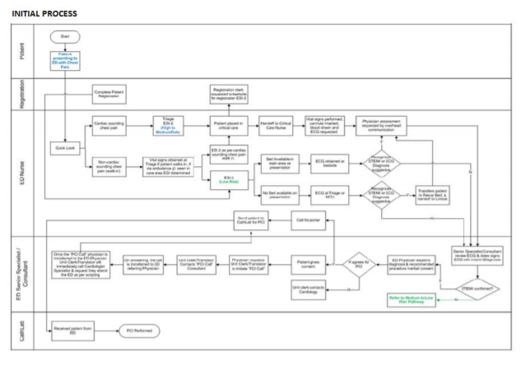
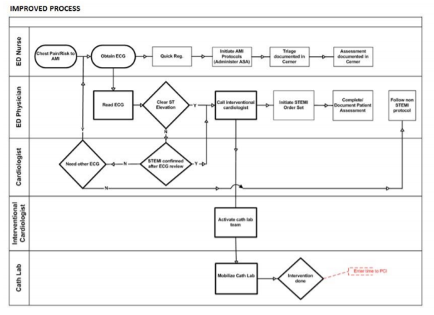
Process Maps
https://www.ncbi.nlm.nih.gov/pmc/articles/PMC4645801/

Slide 159
Creating Maximum Value:
Lean Management in Healthcare
Session 6, Lesson 3
The Ideal State
Jonathan R Modest, MBA, MPH
Instructor

Slide 160
The Ideal State Vision
Definition
  An exercise to envision the perfect process
  Imagine a “World without waste”
  No constraints or limits and 20 years down the line
  Focus on patient or internal customer satisfaction
Purpose
  Opens minds and eliminates bias brought on by current state conditions
  Precedes development of future state (12 month redesign)
  In the next step, when we design the future state, we are taking steps towards this ideal state
Logistics of exercise
  Bullet list of ideal state conditions
  Develop list in ~15 minutes
Notes:
Keep in mind that this is not “santa claus” bringing you whatever you want for christmas…
Striving towards perfection

Slide 161



Creating an Ideal State
Problem: Japanese grocery stores are much smaller than those in the U.S. and could not fit large round watermelons into their stores
Solution: Square Watermelons!
Lessons learned?
  Don’t Assume
  Question the norm
  Be create, DO SOMETHING DIFFERENT
  Impossibilities often aren’t
Notes:
Japanese grocery stores had a problem. They are much smaller than shops in the USA and therefore don't have room to waste. Watermelons, big and round, wasted a lot of space. Most people would simply tell the grocery stores that watermelons grow round and there is nothing that can be done about it.
That is how majority of people would respond. But some Japanese farmers took a different approach. If the supermarkets wanted a square watermelon, they asked themselves, "How can we provide one?" It wasn't long before they invented the square watermelon.
The solution to the problem of round watermelons was not to solve as the farmers did not assume it was impossible, simply asked how it could be done.
They found out that if you put the watermelon in a square box when they are growing, the watermelon will take on the shape of the box and grow into a square fruit.
This made the grocery stores happy and had the added benefit that it was much easier and cost effective to ship the watermelons. Consumers also loved them because they took less space in their refrigerators which are much smaller than those in the US meaning that the growers could charge a premium price for them.
What does this have do with anything in life or at your job? There are a few lessons that can you can take away from this story which help you :
Don't Assume: The major problem was that most people had always seen round watermelons so they automatically assumed that square watermelons were impossible before even thinking about the question. Things that you have been doing a certain way your entire life have taken on the aura of the round watermelon and you likely don't even take the time to consider if there is another way to do it. Breaking yourself from assuming this way can greatly improve your overall life as you are constantly looking for new and better ways to do things. This was one of the most difficult things for me to do because most of the assumptions I make, I don't even realize that I'm making them. They seem perfectly logical on the surface, so I have to constantly make an effort to question them.
Question habits: The best way to tackle these assumptions is to question your habits. If you can make an effort to question the way you do things on a consistent basis, you will find that you can continually improve the way that you work. Forming habits when they have been well thought out is usually a positive thing, but most of us have adopted our habits from various people and places without even thinking about them. I have changed a large number of habits that I have had after taking the time to question them and continue to do so. Some of them I have know idea where they came from while others I can trace to certain people or instances in my life. It's a never ending process, but by doing this, you can consistently strive toward making all aspects of your life more enjoyable instead of defaulting to what you have now.
Be Creative: When faced with a problem, be creative in looking for a solution. This often requires thinking outside the box. Most people who viewed this question likely thought they were being asked how they could genetically alter water melons to grow square which would be a much more difficult process to accomplish. By looking at the question from an alternative perspective, however, the solution was quite simple. Being creative and looking at things in different ways in all portions of your live will help you find solutions to many problems where others can't see them. I am not a creative person, but I've found that the more that you look at things from different perspectives, the more creative I have become. It's a learned art and builds upon itself.
Look for a better way: The square watermelon question was simply seeking a better and more convenient way to do something. The stores had flagged a problem they were having and asked if a solution was possible. It's impossible to find a better way if you are never asking the question in the first place. I try to ask if there is a better way of doing the things that I do and I constantly write down the things I wish I could do (but currently can't) since these are usually hints about steps I need to change. Get into the habit of asking yourself, "Is there a better way I could be doing this?" and you will find there often is.
Impossibilities often aren't: If you begin with the notion that something is impossible, then it obviously will be for you. If, on the other hand, you decide to see if something is possible or not, you will find out through trial and error. Take away the lessons from the square watermelons and apply them to all areas in your life (work, finances, relationships, etc) and you will find that by consistently applying them, you will constantly be improving all aspects of your life.

Slide 162
Ideal State: Patient Access to Urology
Someone always available to answer the phone when a patient calls
Appointment always available for a patient within 14 days
Clinical complications/urgent issues quickly identified
  Triage clinician available as necessary
Medications quickly refilled when needed
Information about patient calls/needs readily available
  Uniform/global information access
All patients registered and active on Patient Gateway
No waste

Slide 163
Future State VSM
Scope
A future state map bridges the gap between the current and ideal states. It incorporates the realities of technical limits, budgets and time.
Draw new process steps
Identify things that need to change to get there
Current State Drawing
Ideal State
Future State
Drawing
Implementation
Plan
A3 Problem Solving

Slide 164
Creating the Future State VSM
Meet the goals set forth in the charter
Review the CS map and study how the process fails. The FS should reduce or eliminate the possibility of process break down
    Start with discussing the 3-5 transformational changes
    Does each process step make only what the next step requires?
Begin to build the FS map
    Is this step needed and value added?
    Can it be simplified?
    Should steps be rearranged or done in parallel?
Capture action items(rapid improvements) at each step as an A3 or a PDSA. Group together the UDEs addressed by each action item.

Slide 165
Future State VSM Symbols
Process Step
Legend:
Who:
When:
Where:
How:
Patient
Material or patient Flow
FMEA
FMEA
Input
Task
Output
Conversation Information Flow
Action Items
Task

Slide 166
Future State Re-Cap
Make sure the future state map solves the root causes of problems…not just the symptoms of those root causes
Only solve problems if all the right people are in the room. The people responsible for the work must are key to solving the problem.
Always ask what could go wrong if we make this change. Which areas do we need to do an FMEA?
Keep in mind the organization’s capacity for change
Ensure you are capturing clear and crisp problem statements for each A3 or PDSA. Make sure the group is in agreement.

Slide 167
Creating Maximum Value:
Lean Management in Healthcare
Session 7: Spaghetti Diagrams
Jonathan R Modest, MBA, MPH
Instructor

Slide 168
A3 Template
PROBLEM SOLVING A3 | TITLE: | Last Saved Date:
TEAM MEMBERS:
PROBLEM STATEMENT:
SCOPE (IN/OUT):
BACKGROUND/CURRENT CONDITIONS:
ROOT CAUSE ANALYSIS:
GOALS:
COUNTERMEASURES (PLAN):
IMPLEMENTATION (DO):
RESULTS /CONCLUSIONS (STUDY):
FOLLOW-UP/ ACTIONS (ACT):

Slide 169

Spaghetti Diagram
Not This:

Slide 170
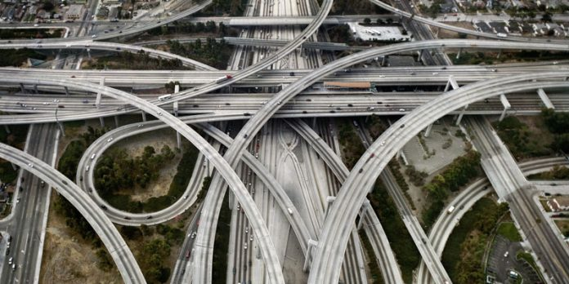

Spaghetti Diagrams

Slide 171
Spaghetti Diagrams
A visual representation of the physical flow of materials, papers and people through the tasks or activities of a process
Details the flow, distance and waiting time of the transportation of items in the process
Traces the walking patterns of people shuttling back and forth of materials between tasks and workstations
https://www.whatissixsigma.net/spaghetti-diagram/

Slide 172
Steps to Spaghetti Diagrams
Plot the physical layout on a piece of paper (often using a floor diagram is best)
Go to them gemba and observe
  The flow of materials, papers
  The walking pattern of people
  Waiting time and stoppages at different points
All the bullets above should be drawn in different colors to distinguish the exact problem
Lines should be redrawn for every trip or movement. The thicker the line, the more complex the process. Care should be taken not to miss minute tasks, small trips and repeated motions
https://www.whatissixsigma.net/spaghetti-diagram/

Slide 173

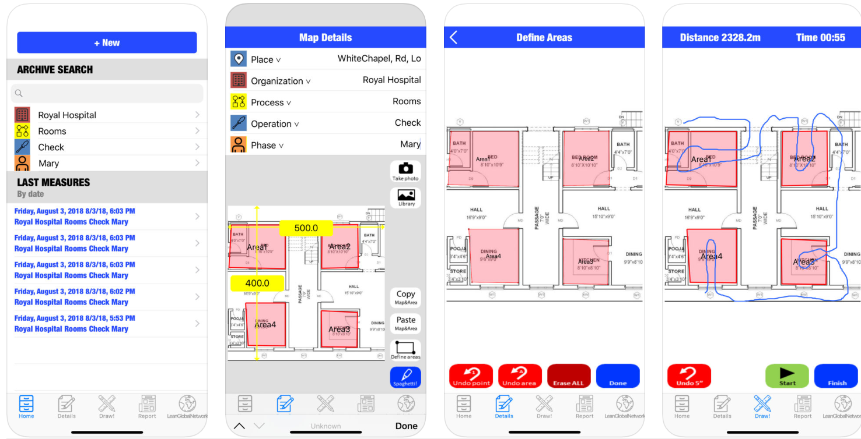
Manual or Electronic!

Slide 174
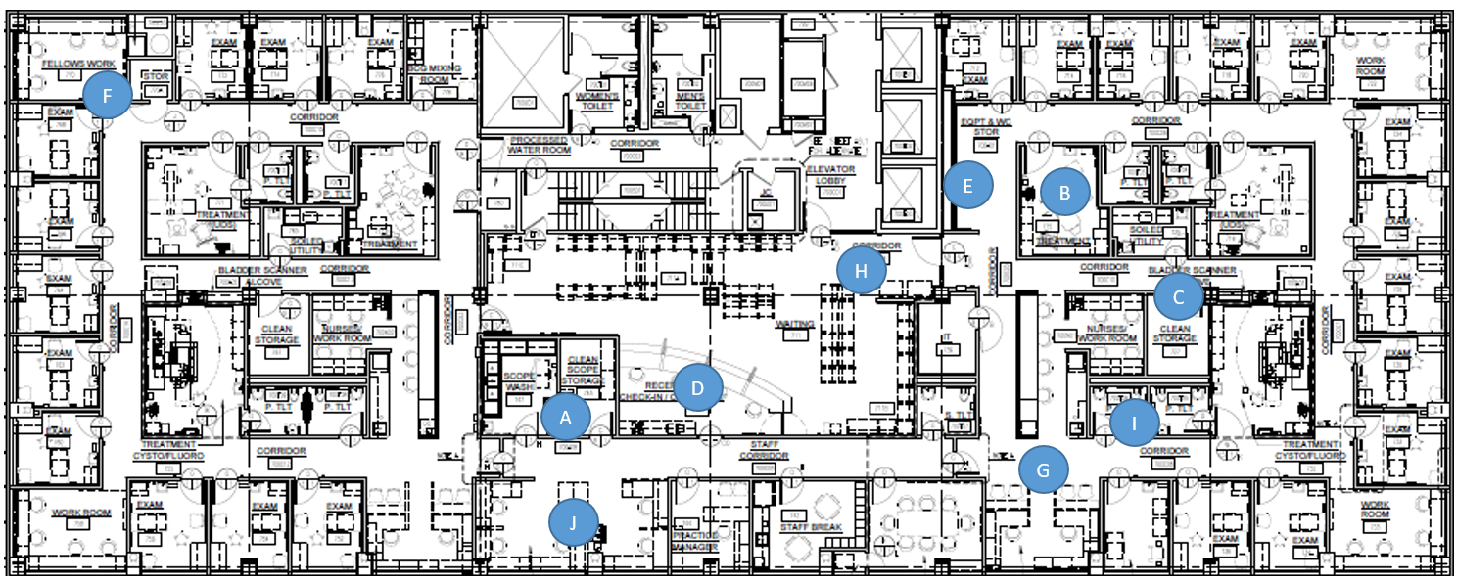
Spaghetti Diagram Live Exercise!
Notes:
Use the following process to draw a spaghetti diagram that represents the flow of the Urology Technician (UT) through clinic:
Starting at Point B, the UT cleans the procedure room after the last patient left and prepares it for the next procedure
The UT walks from Point B to Point A to get necessary instruments for the procedure and returns to Point B
The UT then realizes she forgot a bag of saline and goes to Clean Supply (Point C) to get it and returns to Point B
Once the room is ready, the UT goes to her computer at Point E and sees the patient has arrived. She goes to collect the paper work at point D and then calls the patient from Point H
The UT escorts the patient to the only available bathroom at Point I to collect a urine sample. She then brings the patient to Point B and preps the patient for the procedure
Once the patient is ready, the UT walks from Point B to Point F to get the MD for the procedure, at which time they both return to Point B
Once the procedure is complete, the UT escorts the patient from Point B to the checkout desk at Point G
At Point G, the UT realizes she needs a copy of a consent form and goes to the copy machine at Point J before returning to Point B to prepare for the next procedure

Slide 175
Creating Maximum Value:
Lean Management in Healthcare
Session 8: Voice of the Customer
Jonathan R Modest, MBA, MPH
Instructor

Slide 176
Creating Maximum Value:
Lean Management in Healthcare
Session 9:
Diagnosing the Problem with Root Cause Analysis
Jonathan R Modest, MBA, MPH
Instructor

Slide 177
A3 Template
PROBLEM SOLVING A3 | TITLE: | Last Saved Date:
TEAM MEMBERS:
PROBLEM STATEMENT:
SCOPE (IN/OUT):
BACKGROUND/CURRENT CONDITIONS:
ROOT CAUSE ANALYSIS:
GOALS:
COUNTERMEASURES (PLAN):
IMPLEMENTATION (DO):
RESULTS /CONCLUSIONS (STUDY):
FOLLOW-UP/ ACTIONS (ACT):

Slide 178
Problem Solving
Initial perception of problem
Grasp the situation
What is the actual problem in performance?
Clarify the problem
Go to the Gemba and understand the
way the work is done
Problem breakdown
Go to the gemba, get the facts first-hand, analyze them thoroughly and objectively
Focus on the process
Be Respectful
Blame the process, not the person. Where did the process fail?
Determine
Root
Cause
Cause investigation
Determine the root cause of why the problem is occurring.
178

Slide 179

Root Cause: Why Bother?
Problem Manifestation

Slide 180

Chasing the Manifestation

Slide 181
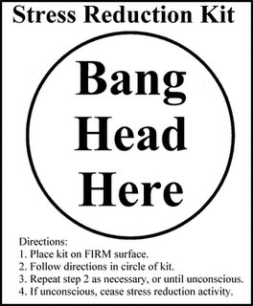
And this becomes your best problem solving method

Slide 182
Identifying Causation: Fishbone Diagram
Machine
Method
Measure
Problem
Materials
People
Environment

Slide 183
Steps to Fishbone Diagrams
Write 4-6 main categories on a whiteboard, flipchart, or document sharing system
Write the effect of the problem as the head of the fishbone
List all possible causes of the problem (or effect) in the categories
Prioritize causes that need to be investigated further via data collection, beta test, etc
Identify the top few items
Brainstorm with top problems through data collection or conduct a 5 why analysis

Slide 184
The Fishbone at Work – Live Exercise
Machine
Method
Measure
Medical assistants don’t know when patient arrives
Documentation takes too long
High volume clinic
Cumbersome order entry
Patients are double booked
MDs don’t know where to go next
Quality measure visit requirements
Visit wait times are too long, leading to extreme delays and resulting in unhappy patients
Not enough exam rooms
MDs are multitasking
Patients are double booked
MDs are documenting
Elderly patient population
Supplies not readily available
Medical Assistants are supporting multiple MDs
Patients arrive late
Complex care environment
Materials
People
Environment

Slide 185
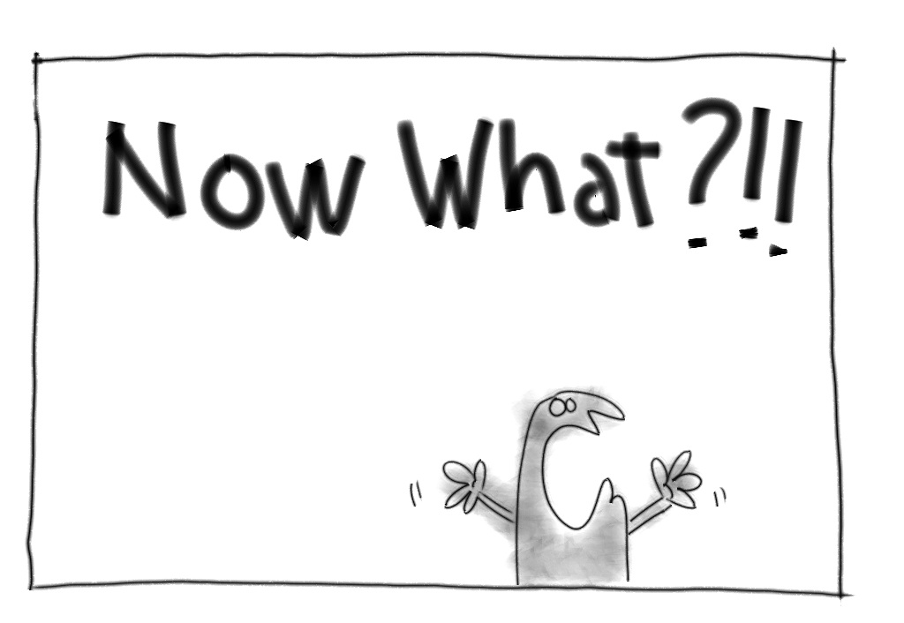

Slide 186

5 Whys
Allows organized brainstorming to methodically determine the cause of a problem (ie effect). Most often teams observe a symptom of the problem rather than the problem itself

Slide 187
5 Whys Steps
List the top 2 – 5 potential main causes of the problem identified from the Fishbone Diagram
Ask “Why” five times for each potential cause to get to the root cause
Use the information to start a plan for additional data collection and testing or an improvement implementation activity

Slide 188
Why ask Why?
“To tell the truth, the Toyota Production System has been built on the practice and evolution of this scientific approach. By asking ‘why?’ five times and answering it each time, we can get to the real cause of the problem, which is often hidden behind more obvious symptoms”
- Taiichi Ohno, Toyota

Slide 189
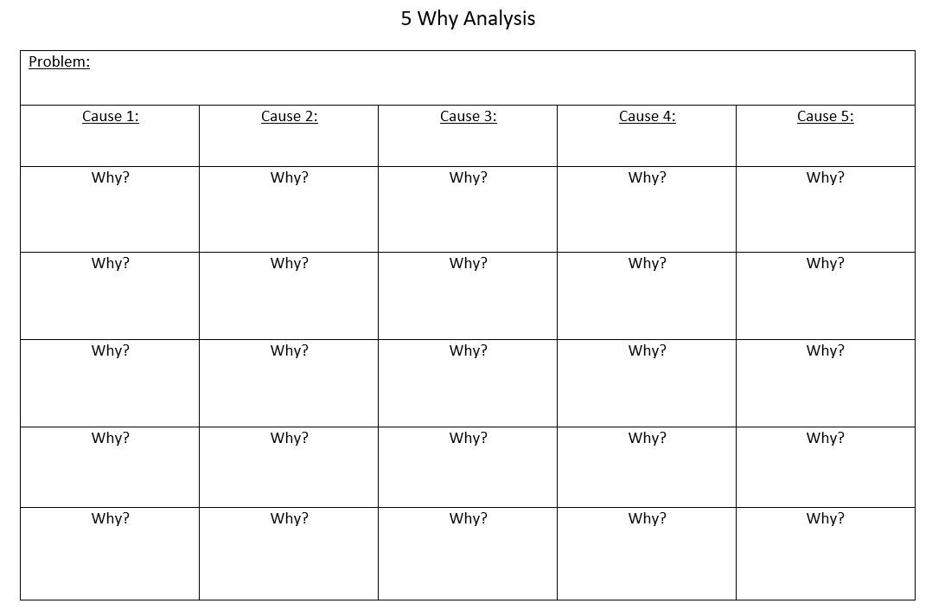

Slide 190

But which cause do I start with?...
…it doesn’t matter! Just start somewhere!

Slide 191
Root Cause Exploration #1
Patients arrive late
  Why?: Because they don’t know they have an appointment
  Why?: Because they forgot
  Why?: Because they did not receive a reminder
  Why?: Because they didn’t answer the reminder call
  Why?: Because they didn’t recognize the phone number

Slide 192
Root Cause Exploration #2
Patients are double booked
  Why?: Because the MD schedule doesn’t have enough slots
  Why?: Because patient demand exceeds capacity
  Why?: Because the department doesn’t have enough providers

Slide 193
“Making this logical sequence clear and explicit enables individuals and teams to concentrate on important matters and to discuss them in productive terms”
– John Shook, Managing to Learn
“Five whys equals one how”
- Taiichi Ohno, Toyota

Slide 194


Slide 195
Fishbone examples

Slide 196
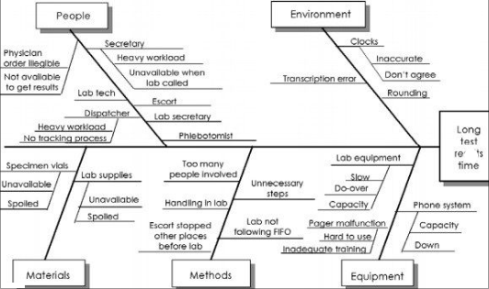
Long Test Results Time

Slide 197
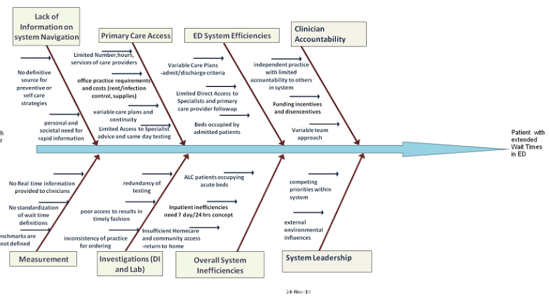
Long Test Results Time

Slide 198
Creating Maximum Value:
Lean Management in Healthcare
Session 10: Failure Mode Effects Analysis
Jonathan R Modest, MBA, MPH
Instructor

Slide 199
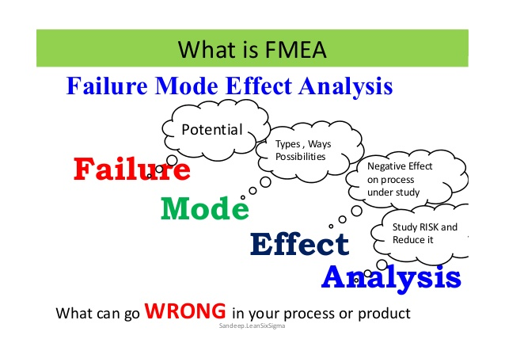

Slide 200
Failure Modes and Effect Analysis
A methodology for discovery of and prioritization of existing or potential failures in process, product or design applications.
“Failure modes” means the ways, or modes, in which something might fail. Failures are any errors or defects, especially ones that affect the customer, and can be potential or actual.
“Effects analysis” refers to studying the consequences of those failures.
Begun in the 1940s by the U.S. military, FMEA was further developed by the aerospace and automotive industries.

Slide 201
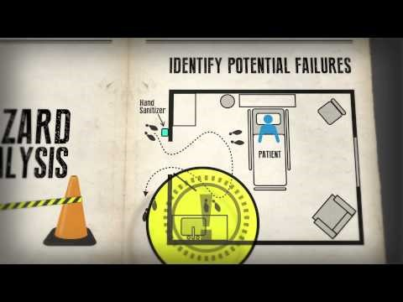
FMEA
Notes:
https://www.youtube.com/watch?v=yOLfe37gq4g

Slide 202
Why FMEA?
  Minimize Errors
  Minimize PDSA cycles
  Minimize Resource fatigue
  Enables depth and breadth of change
  Right first time mentality
  When I ask, “What can go wrong?”, I always get at least one answer
  Problems = Opportunities, if you are not surfacing problems, then you are not improving
  Frontline involvement to embrace change and to help in design and implementation

Slide 203
When to Use FMEA
New Process (e.g. registration, call center, access command center)
New position (e.g. nurse practitioners for admit or discharge)
Broken Process (e.g. long waits, defects)
New layout or facility design
New IT implementation
New Product (e.g. medication, device, tool)
Root cause analysis
Countermeasure Planning

Slide 204
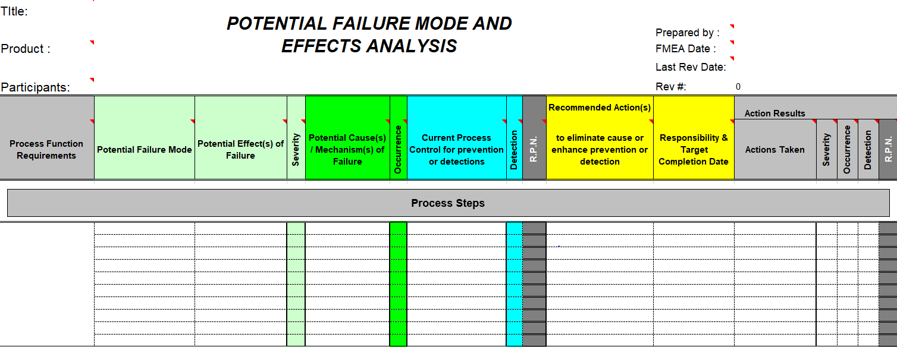
FMEA Template

Slide 205
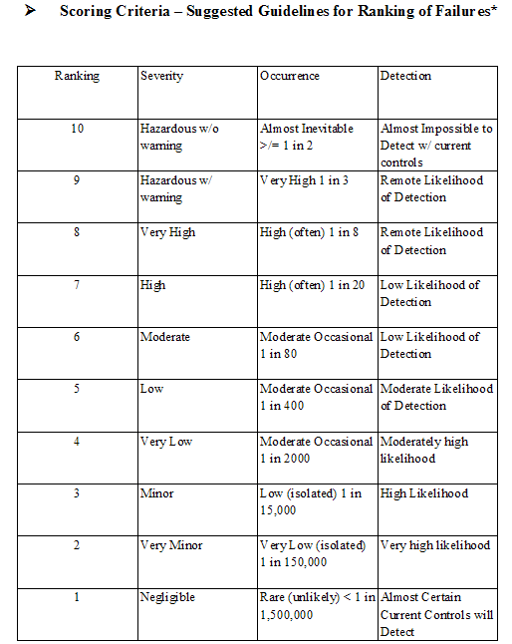
Scoring

Slide 206
Let’s FMEA – Asynchronous Learning
MGH Urology is redeveloping its access protocols. Each surgeon has their own phone number, answered by a coordinator whose responsibilities, in addition to answering phones and responding to patient needs (scheduling, Rx refills, questions, etc) also includes preparing for and supporting providers during clinic as well as other responsibilities.
The new process involves all phone calls coming into a single phone line. Calls will be answered by a Scheduling Specialist, who will work of a standard protocol to determine how to best assist
Appointment scheduling will be handled immediately, questions will be forwarded to the proper professional

Slide 207
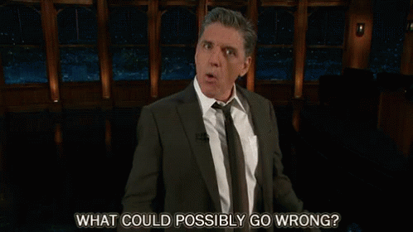

Slide 208
Creating Maximum Value:
Lean Management in Healthcare
Session 11: Data Collection and Analysis in Lean
Jonathan R Modest, MBA, MPH
Instructor

Slide 209
Creating Maximum Value:
Lean Management in Healthcare
Session 12, Lesson 1:
Treating the Problem: PDSA and Standard Work
Jonathan R Modest, MBA, MPH
Instructor

Slide 210
A3 Template
PROBLEM SOLVING A3 | TITLE: | Last Saved Date:
TEAM MEMBERS:
PROBLEM STATEMENT:
SCOPE (IN/OUT):
BACKGROUND/CURRENT CONDITIONS:
ROOT CAUSE ANALYSIS:
GOALS:
COUNTERMEASURES (PLAN):
IMPLEMENTATION (DO):
RESULTS /CONCLUSIONS (STUDY):
FOLLOW-UP/ ACTIONS (ACT):

Slide 211
Countermeasures: Tools to support change

Slide 212
For each countermeasure, consider…
Model for Improvement
Act
Plan
What are we trying to
accomplish?
How will we know that a
Study
Do
change is an improvement?
What change can we make that
will result in improvement?
PDSA Cycle 1 . . PDSA Cycle 2 . . PDSA Cycle X.
Until you achieve the improvement you seek
Reference: IHI Model for Improvement.

Slide 213
GAP
Apply Countermeasures to get to the Target Condition
A P
S D
Target Condition
A P
S D
A P
S D
The A3 tells the story
A P
S D
Current Condition

Slide 214
Countermeasures (Plan)
GET APPROVAL
Devise countermeasures (treatment plans) and visualize the future state
Evaluate possible fixes based on effectiveness, cost, and time to implement. Which solutions should you trial?
Every countermeasure should:
  Be a lean tool or principle
  Eliminate waste
  Be aligned with the goals of the A3
  Be “right sized”
Verify the countermeasure will not remove or violate an existing compliance, privacy, or IS policy
Test on a small scale, if possible
Ask what could go wrong with your new process? What can be put in place to prevent those failures? (FMEA)
Notes:
Potential questions for attendees:
What is a problem in your department and a potential countermeasure?
What are lean tools & examples? Std work, visual management system, right size

Slide 215
Countermeasures
    Root cause #1
    Root cause #2
    Root cause #3
    Countermeasure #1: Develop standard process for surgical admissions
    Countermeasure #2:
    5S surgical admissions patient rooms

Slide 216
Lean Tools
Examples of Countermeasures:

Slide 217
Standard Work
Goal is to establish and make the best method consistent among everyone
Well-defined, precise procedures for each person’s work
  Includes work sequence, equipment and inventory required
Reduces variation
Key to continually improving a process
Visual pictures or video supplement can be very helpful

Slide 218
Steps to Standard Work
Define the process through process mapping
Collect timely process data. Gather data from the EHR using an appropriate sample size. Establish desired task lengths. Best practices may include national benchmarks (MGMA, HEDIS)
Review the steps for waste and define best practice/standard work

Slide 219
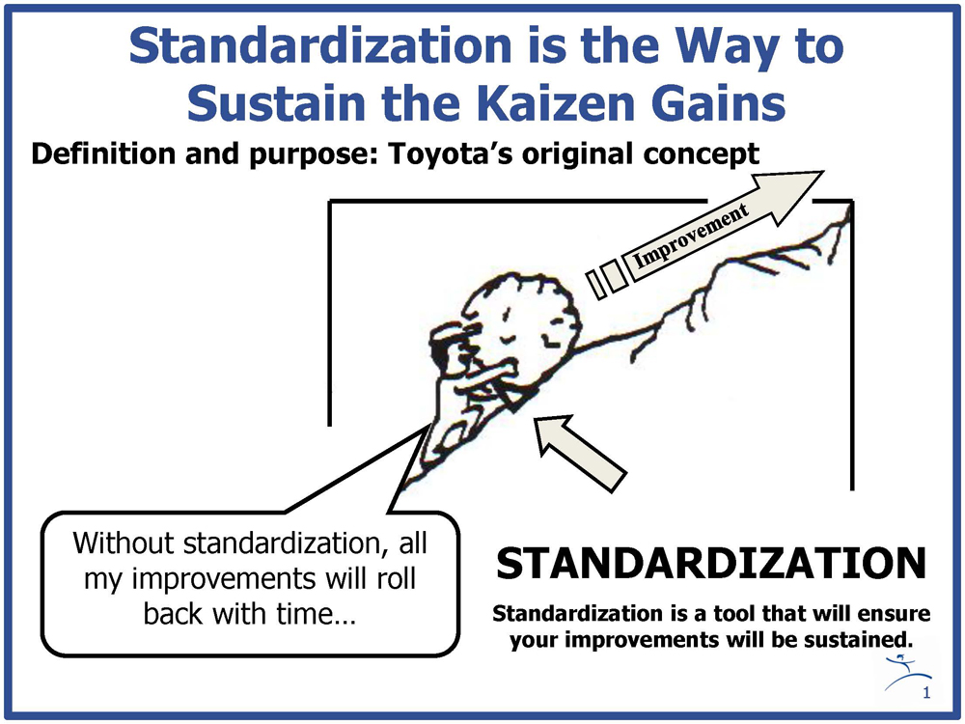

Slide 220
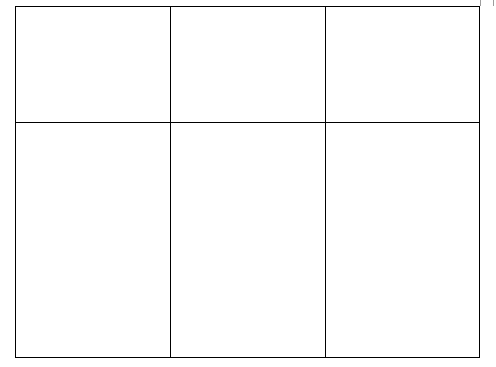
Draw a Pig

Slide 221

Standard Work
Notes:
https://www.youtube.com/watch?v=v-ThBEAZ5jo

Slide 222
Examples in Healthcare
Surgical tray set-ups
Exam room set-ups
Out of Office protocols
Sterilization protocols
Daily huddles

Slide 223

Checklists

Slide 224


Standard Operating Protocols

Slide 225
Creating Maximum Value:
Lean Management in Healthcare
Session 12, Lesson 2:
Treating the Problem: 5S and Mistake Proofing
Jonathan R Modest, MBA, MPH
Instructor

Slide 226
5S
Visual Management
To address problems associated with wasted time and wasted talent in searching for supplies & equipment to perform work
  Sort and scrap
  Straighten/Set in Order/Stabilize
  Shine/sweep
  Standardize
  Sustain
Make operations visually obvious
Make problems stand out – make it easy to identify error conditions
Easy tracking of up to the minute process performance
Andon – a light or signal that a worker needs help immediately (to indicate a problem or abnormality has been detected

Slide 227





5S of ED Workstation
Before

Slide 228





5S of ED Workstation
After

Slide 229

Visual Management: Inpatient Floor
Where are all the charts?
When someone takes a patient chart with them, they fill out a card with their name, pager, and location in case someone else needs the chart

Slide 230

Visual Management: Room Flags

Slide 231

Mistake Proofing (Poka Yoke)
A system designed to ensure that it is impossible to make a mistake or produce a defect.
Also known as error proofing
Poka Yoke – a physical or electronic mechanism that prevents a mistake from being made or ensures that if one is made, it is obvious at a glance
Benefits from standard work

Slide 232
Defects v. Errors
To be a Defect:
To be an Error:
The process or service deviates from specifications or standards of service
The process or service does not meet customer (internal or external) expectations
An action in the process deviates from an intended action, or an action is not performed or another actions is performed instead of the required one
All defects are created by errors, but not all errors result in defects

Slide 233
Poka Yoke Examples
Marking the intended surgical site
Three patient identifiers
Checklists

Slide 234
Creating Maximum Value:
Lean Management in Healthcare
Session 12, Lesson 3:
Treating the Problem: Total Productive Maintenace, Just in Time, and Pull/Flow Systems, Kanban
Jonathan R Modest, MBA, MPH
Instructor

Slide 235

Total Productive Maintenance
Notes:
https://www.youtube.com/watch?v=nb031_LQIHQ

Slide 236
TPM
Refers to the tools, methods and activities used to improve machine equipment availability and reliability time
Regular inspections and audits
Monitor mean time between failures and mean time to repair
Common machine time losses
  Breakdowns, set-ups and adjustments
  Minor stops and waiting
  Running defective products or creating error and rework
  Speed losses to standards
  Start-up yield losses

Slide 237

What happens if this goes down?

Slide 238

Or This….

Slide 239

Or This!

Slide 240
Flow and Kanban

Slide 241

Pull Systems
PUSH
Push System: High inventory, producer centric, make-to-stock, forecasting demand
Pull System: Limited inventory, customer centric, make-to-order
  Pull = response to demand
  Pull means the customer getting what they want, when they want it, in the right amount.
  “Kanban” or signal for production
PULL

Slide 242

Pull
No one upstream should produce a good or service until the customer downstream asks for it
Stocking in a clinic, floor or OR

Slide 243


Slide 244
https://www.youtube.com/watch?v=oysPPTxdnt0

Slide 245
Flow
There are 3 basic flow methods
  Continuous/One-Piece flow
  Paced Flow
  Scheduled Flow

Slide 246
Continuous Flow
When a customer orders or demands are initiated and the process continues uninterrupted until the order or demands are satisfied
Examples include:
  Level 1 Trauma
  Stat lab orders
  Surgical procedures
  Labor and delivery
Most successful when
  Order urgency = high
  Order pattern = irregular or unpredictable
  Order fulfillment process = predictable or standardized

Slide 247
Paced Flow
Customer order fulfillment tasks are done with regular frequency on a timed schedule
Examples include:
  Physician rounds
  Dispensing medications
  Lab pick-ups
  Food delivery and pick-ups
Most successful when:
  Order Urgency = Medium
  Order Pattern = Regular and predictable
  Order Fulfillment Process = Predictable or standardized

Slide 248
Schedule Flow
Customer orders or demands are known or predicted and then scheduled or reserved for fulfillment at a specific time
Examples include:
  Doctor appointments
  Dialysis treatments
  MRIs
Most successful when:
  Order Urgency = Low
  Order Pattern = Irregular or unpredictable
  Order Fulfillment Process = Unpredictable or non-standard

Slide 249
Go with the Flow
High
Continuous
Flow
Paced
Flow
Urgency
Schedule
Flow
Low
Predictability
High

Slide 250
Flow Tools
Heijunka Leveling - Works to level or smooth flow by delivering goods and/or services in an alternating or patterned manner rather than large chunks of time
Pull Systems and Kanbans
  Pull systems: process to ensure nothing is produced upstream until the downstream process “signals” the need for it
  Kanbans: “Pull signals” that serve as visual signals used to control flow and trigger action between processes
First-In First-Out (FIFO) – ensures the oldest work upstream is the first to be processed downstream

Slide 251

Kanban in Healthcare!
Notes:
https://www.youtube.com/watch?v=yjSwwPF5BUU

Slide 252
Creating Maximum Value:
Lean Management in Healthcare
Session 13: The Kano Model
Jonathan R Modest, MBA, MPH
Instructor

Slide 253

Kano Model

Slide 254

Kano Model
There are unexpected features which, when presented, cause a positive reaction. These are usually called Attractive, Exciters or Delighters
Some product features behave as what we might intuitively think that Satisfaction works: the more we provide, the more satisfied our customers become.
Other product features are simply expected by customers. If the product doesn’t have them, it will be considered to be incomplete or just plain bad. This type of features is usually called Must-be or Basic Expectations
https://foldingburritos.com/kano-model/
https://asq.org/quality-resources/kano-model

Slide 255

Kano in Healthcare

Slide 256
Asynchronous Learning – 10 Minutes
You are a consultant brough into a hospital to help them understand how to address extended wait times in their ambulatory setting:
Identify an example of a(n):
  Expecting Quality
  Normal Quality
  Exciting Quality
as it relates to patient visit expectations

Slide 257
Creating Maximum Value:
Lean Management in Healthcare
Session 14, Lesson 1:
Developing Recommendations: SMART Goals and Decision Analysis
Jonathan R Modest, MBA, MPH
Instructor

Slide 258

Setting the Stage for Successful Recommendations and Implementation

Slide 259

SMART Goals

Slide 260
Decision Analysis
What is It?
A logical procedure for the balancing of the factors that influence a decision
Incorporates uncertainties, values, and preferences in a basic structure that models the decision
Why is it Helpful?
Helps gain consensus on possible options
Provides quantitative support to decision-makers

Slide 261

Decision Analysis Explanation
Musts & Wants
What It Is Used For
  To help select between alternatives
When to Use It
  In selecting a solution to a problem, this can be used to decide between alternatives.
Important Notes
  To even be considered, a potential solution is required to meet all of the “Must” criteria.
  In evaluating the wants, it is best to use the expertise of a team. This will give the best ranking of the potential solutions.
Source: http://www.qualitytrainingportal.com/resources/problem_solving/problem-solving_tools-musts_wants.htm

Slide 262
Decision Analysis
Purpose is to decide between alternative solutions; identify your musts and wants, rank & weight them. The example below is from the Rapid Medical Exam process at Health Alliance.

Slide 263
Steps to Decision Analysis
Step 1: Value of the countermeasure
Step 2: Identify Options
Step 3: Identify Selection Criteria
  Musts – no design/countermeasure will be considered if it does not meet the must
  Wants – weigh each want based on how important it is on a 1-10 scale
Step 4: Weigh each option based on wants
  For each option, weigh how good that design/countermeasure satisfies each want
Step 5: Use output to help make decisions

Slide 264
Examples of Selection Criteria
Musts:
Can not Reduce 25 bed capacity
Must maintain safety and quality
Aligns with Strategic Plan
Reduce Wait times
Have RME separate station
Must have a positive financial impact (increase revenue or decrease expenses)
Maintain patient experience
Must have short time frame to implement(6 to 12 months)
Wants with Weighting:
Increase provider/Rapid Triage/RME productivity (10)
Improves Patient experience/satisfaction (9)
Increase safety (8)
Increase Quality (7)
Can be done quickly (6)
Improves employee satisfaction (5)
Low capital investment(4)
Does not increase operating cost (3)

Slide 265
Decision Analysis: Step by Step
Identify the options
Identify the Musts
  Analyze each option to see if it meets all of the musts (Yes or No)
  If No, this option is no longer considered
Identify the Wants
  Rate each want on a scale 1-10 based on how important that want is (in evaluating the wants, it is best to use the expertise of a team).
  Then, rate each option on a scale 1-10 based on how well that option satisfies each individual Want
A Mathematical model is used to quantify the “success factor” of each option, based on how well each option meets each wants

Slide 266

Example

Slide 267
Asynchronous Learning – 25 Minutes
You have continued your work as a consultant brough into a hospital to help them understand how to address extended wait times in their ambulatory setting. Your completed your Root Cause Analysis (Fishbone and 5 Whys from Session 9).
Think about 2-3 countermeasures/recommendations you would make to solve the wait time problem
Perform a decision analysis to help prioritize your options

Slide 268
Creating Maximum Value:
Lean Management in Healthcare
Session 14, Lesson 2:
Developing Recommendations: Prioritization Matrix and Scorecard
Jonathan R Modest, MBA, MPH
Instructor

Slide 269
Prioritization Matrix
26 , 42, 37, 21, 14
High
2, 4, 8, 10, 18 19, 9
19, 27
Disease Specific Education
Medication
Clinical Path & Decision Making Algorithm
1, 24, 30, 31
Communication
3, 5, 40
Impact
Risk Assessment
Priority
Low
Low = Start 6 months
High = Start Now
Low
High
Ease of Implementation

Slide 270

Scorecard Example
Original Problem
Action Items
Project Type (A3 or PDSA)
Due Date/Timeline
Person responsible for each
Comments/Status
Metrics
Notes:
Document all changes needed to move from Current to Future State in an Action Plan (standard format)
Link each action to an Original Problem
Assign responsibility and due dates
Decide how to measure each action (metric)
Make sure communication, standard work development, and training are part of the plan
Make sure Measurable/Results Board is part of plan
Sequence the tasks from beginning to end (turn-by-turn driving directions)

Slide 271
Asynchronous Learning – 10 minutes
Using your 2-3 countermeasures from your consultant work trying to improve wait times:
Use the Decision Analysis from a few moments ago to help inform your impact scores
Think about the potential ease (or lack thereof) of implementation
Identify where your examples might land on a prioritization matrix

Slide 272
Creating Maximum Value:
Lean Management in Healthcare
Session 14, Lesson 3:
Simon Sinek’s Golden Circle
Jonathan R Modest, MBA, MPH
Instructor

Slide 273

Simon Sinek’s Golden Circle
Notes:
https://www.youtube.com/watch?v=qp0HIF3SfI4

Slide 274




Simon Sinek’s Golden Circle
Lea
ders
Managers
Front Line Staff
You must know why in order to successfully navigate transformation!

Slide 275

We’ve Talked about culture…

Slide 276
Think Systematically
Typical Approach | Systems Thinking Approach
Static Thinking | Dynamic Thinking
Focusing on particular parts. Assuming parts never change over time | Assuming parts and processes evolve over time.
Linear Thinking | Highly Integrated
Viewing parts as having one directional impact, ignoring that interactions between other parts have an impact in the outcome. We see this mindset as a ‘chain with the weakest link causing the problem.’ | Viewing all parts as highly interconnected to accomplish a common outcome. These interconnections are more like a web.
Managing the Parts | Managing the Whole (Holistic Approach)
Viewing behavior generated by a system as driven by an individual element or part | Placing responsibility for a behavior by a system as driven all elements. The whole does not equal the sum of the parts.

Slide 277
Creating Maximum Value:
Lean Management in Healthcare
Session 14, Lesson 4:
Understanding Triggers
Jonathan R Modest, MBA, MPH
Instructor

Slide 278
Understanding Triggers
Behavior =
Motivation + Ability + Trigger
indicator
reminder
cue
sign
call to action
prompt

Slide 279



3 Types of Triggers
coach
spark
signal
Develops behavior that is new or difficult
motivates behavior to continue
indicates when to execute behavior
High motivation
Low ability
Low motivation
High ability
Moderate motivation
High ability
Difficult or
New Behavior
Familiar
Behavior
Common
Caution: the wrong kind of trigger can be annoying and condescending

Slide 280

Reactive and Proactive Triggers
Reactive
Proactive
T
coach
T
coach
T
spark
T
spark
T
signal
T
signal
(* The secret in controlling behavior…is to control the trigger!)

Slide 281
Create Your Implementation Plan
The implementation plan is the specific steps to get from the current state to the future state
  Should include problems being addressed, responsible person, and due date
Divide Action Items into PDSAs and A3s
At least one Action Item should be a Communication Plan for All affected
Is this Implementation plan sufficient to achieve goals in charter?
Address What’s In It For Me?
  Increase Quality/Safety, Increase Access, Decrease Costs
  Add up Potential Savings $$ using Lean Scorecard

Slide 282
Project Recommendations/ Implementation Plan Should:
Seek to address root causes
Be realistic
Take into account the workings and culture of the organization
Consider WHY?
Be innovative
Account for industry best practices
Include SMART goals
Balance “Musts” and “Wants” (Decision Analysis)
Be evaluated against impact and ease of implementation (Prioritization Matrix)

Slide 283
Creating Maximum Value:
Lean Management in Healthcare
Session 15:
Sustaining Success
Jonathan R Modest, MBA, MPH
Instructor

Slide 284
Revisiting PDSA: Do (Implement)
EXECUTE
Implement countermeasures and execute future state
  Which alternative solutions have you decided to trial?
  What will be the main actions in the implementation process, and in what sequence?
  What support and resources will be required?
  Who will be responsible for what, when & how much?
  When will progress & impact be reviewed & by whom?
  Use a Gantt chart to display actions, steps, outcomes, timelines & roles
  How will we know if we were successful?
Notes:
Study/Act is often the most overlooked part of the process (think of the dancing bears from the video we watched earlier)
Potential questions for attendees:
What are some ways to Study countermeasures such as standard work? (Auditing, Observation)

Slide 285
PDSA Plan (Tests of Change)
Date | Description of Intervention | Results | Action Steps
5/1/2017-5/31/2017 | Faculty Meeting Presentation: Promote utilization of available resource, sheath cystoscope. Survey providers to determine comfort level using sheath scopes. | 9 out of 13 responses to survey assessing comfort 5 comfortable using sheath cystoscope 4 not comfortable using sheath cystoscope | For comfortable physicians, create Provider Specific Guidelines. Identify Sheath Cystoscope Provider Champion. Present to Residents.
5/31/2017– present | UT Presentation & Survey: Sent survey to Urology Technicians to assess comfort level with each part of sheath cystoscope set up and turn over. | 10 out of 14 UTs responded saying they are comfortable performing sheath cystoscope and do not need further training. | Sterile Processing Tech certified in set up of sheath cystoscope. More Urology Technicians will become certified.
6/12/2017- present | Patient Identification & Communication: Add decision aide signage & Provider Guidelines to UT work stations. Incorporate Sheath Cystoscope usage into huddle . | To be determined | To be determined
Notes:
PDSA we

Slide 286
Project Management: Action Item List
Counter-measure | Action | Who | By When | Status
1 | Draft standard process | Jonathan | Feb. 1 | In progress
1 | Document pilot plan – how long, patient types, how to measure? | Lauren | Feb. 1 | In progress
1 | Pilot new standard process | Team | Feb. 1 – Feb. 12 | Not started
2 | Create model patient room | Lauren, Jenna | Feb. 8 | Not started
2 | Gather feedback on model room, finalize standard | Team | Feb. 15 | Not started
2 | Standardize all patient rooms | Lauren, Jenna | Feb. 19 | Not started

Slide 287
Don’t Forget About Gantt Charts!

Slide 288
Results and Reflection: Study
Study the results and ask what happened
  What happened during the trials – study the positive and negative effects
  What went well?
  What didn’t go well?
  What did you learn?
  Any key insights or AHA moments to inform future success?
  What do people say about the change?
  What do customers say about the change?
WHAT HAPPENED

Slide 289
Follow-Up Actions
NOW WHAT?
Use insights gained to make decisions on future PDSA cycles
  Was the problem eliminated?
  Was the countermeasure successful?
  Do other people or processes need to be involved?
  Accept, reject or modify aspects of the trials to achieve desired outcomes
  What related issues or unintended consequences do you anticipate & what are your contingencies?
  What processes will you use to enable, assure & sustain success?
  What will you do next?

Slide 290
Common Traps
Fixing things that should not be happening at all
Not understanding the larger process of which this is a part
Jumping to the countermeasure without having a deep understanding of the problem
Not clearly understanding the needs of the organization
Not tying your A3 to the larger goals of the organization
Focusing on symptoms, not root causes
Viewing people as the problem instead of the process being the problem
Notes:
i.e. making non-value added activities more efficient – ask the audience if they have an example… here’s one: Coffee and music in the waiting room. Don’t create a countermeasure for a problem that isn’t real. Instead, remove the waiting for the patient and then there will be no need for coffee.

Slide 291


Slide 292

Lean
Womack’s and Jones’ Steps for Implementing Change and Institutionalizing the Revolution

Slide 293

Step 1: Find a Change Agent
“No organization has ever undergone dramatic and comprehensive change without some somewhere, softly or in a loud voice, taking the lead”

Slide 294

Step 2: Get the Knowledge
The most valuable aspect of this work is not the improvement in performance in a specific process, but the raised consciousness of the managers involved in the change process and their enthusiasm for tackling other problems using this knowledge

Slide 295

Step 3: Find a Lever by Seizing the Crisis
The current era of stagnation is not an excuse to avoid or abandon efforts to improve current operations
Make decisive recommendations and suggestion, take decisive actions
Use constraints of the system around you to justify the need to change (ie declining reimbursements)

Slide 296
Steps We’ve Already Discussed
Step 4: Map your Value Streams
Step 5: Reorganize by product family or value stream

Slide 297

Step 6: Create a Lean Promotion Function
Make lean tools and culture transparent and available for all to see
Use process improvement to start a conversation

Slide 298

Step 7: Once you’ve fixed something, fix it again!
Kaizen and PDSA support continuous improvement

Slide 299

Step 8: Utilize Policy Deployment
Build and deploy policies that help support what you’re trying to accomplish and to help build a foundation for implementation

Slide 300

Step 9: Convince EVERYONE to Take these Steps
Colleagues, suppliers, customers, staff should all share in the value stream
Engagement from everyone supports continued improvement

Slide 301
Final Thoughts
Don’t lose sight of the fact we are working with people!
Acknowledge resistance - don’t let it stop or discourage you!
Create space for people (and yourself) to breathe - become self aware - gain emotional control then support them.

Slide 302

Lean in Real Life:
Notes:
https://www.netflix.com/watch/80209468?trackId=14277281&tctx=0%2C4%2Cce50ee08-c9ef-4d50-9b4c-d31566babaa2-10353843%2C%2C
From Students to Improvements

Slide 303
KonMari Method
Commit yourself to tidying
Imagine your ideal lifestyle
Finish discarding first
Tidy by category, not location
Follow the right order
Ask yourself if it sparks joy

Slide 304

Lean in Real Life:

Slide 305
Creating Maximum Value:
Lean Management in Healthcare
Asynchronous Learning
Jonathan R Modest, MBA, MPH
Instructor

Slide 306

Go to the Gemba: See and Learn
Watch by Lesson 4
Notes:
https://www.youtube.com/watch?v=A_DGAGzyPEg

